Slide 1
Robot technologies for order picking
Martijn Wisse
Professor Biorobotica
Scientific director – TU Delft Robotics Institute

Slide 2
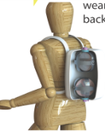
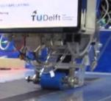
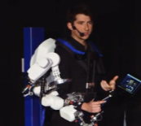
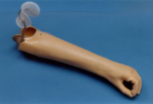
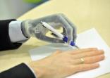
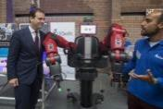
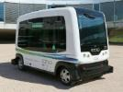
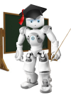
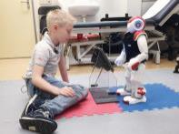
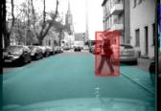
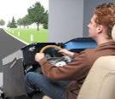
Notes:
“claim to fame” (1) DRI (2) APC

Slide 3
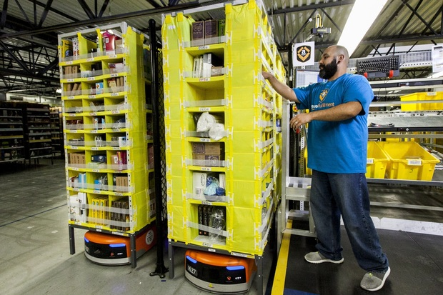
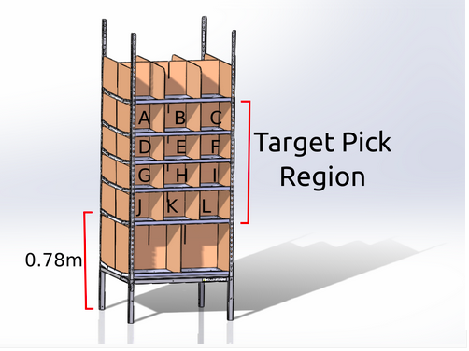
Amazon Picking Challenge
15 minutes
12 objects out of 39
5 minutes preparation after
receiving task file
+ picked object
++ difficult objects
++ full bins
- high drops / damage
- misplaced items
10 cm distance
Metal + cardboard + crooked
Deep bins (compartments)
Notes:
Success
(Traction,
Popularity,
Fame)

Slide 4
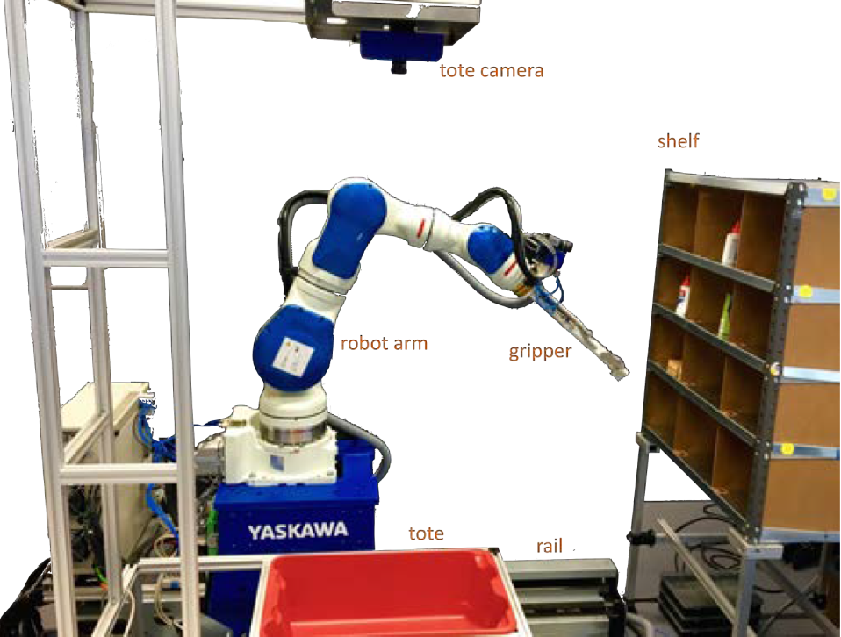
Notes:
Success
(Traction,
Popularity,
Fame)

Slide 5
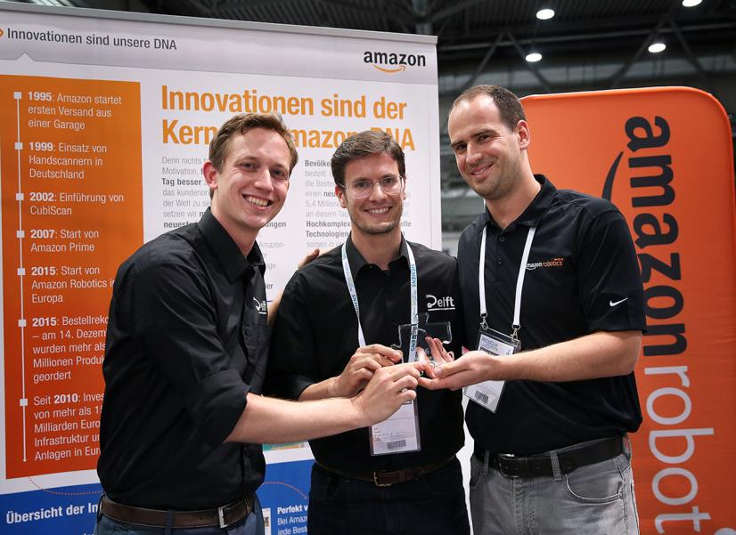
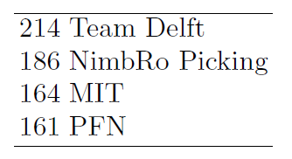
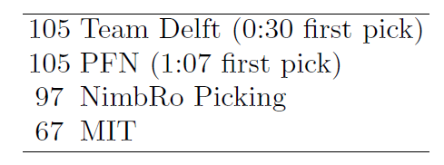
Stow task
Pick task
Notes:
Success
(Traction,
Popularity,
Fame)

Slide 6
Object recognition
Pose estimation
Motion planning
System integration

Slide 7
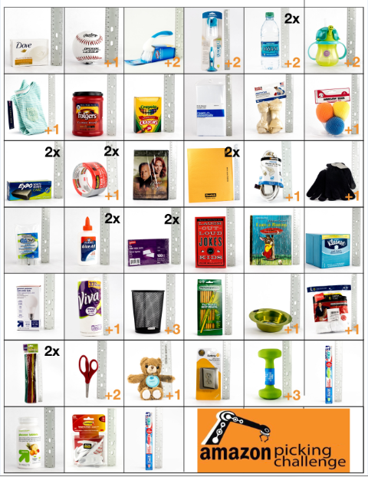
Notes:
Success
(Traction,
Popularity,
Fame)

Slide 8
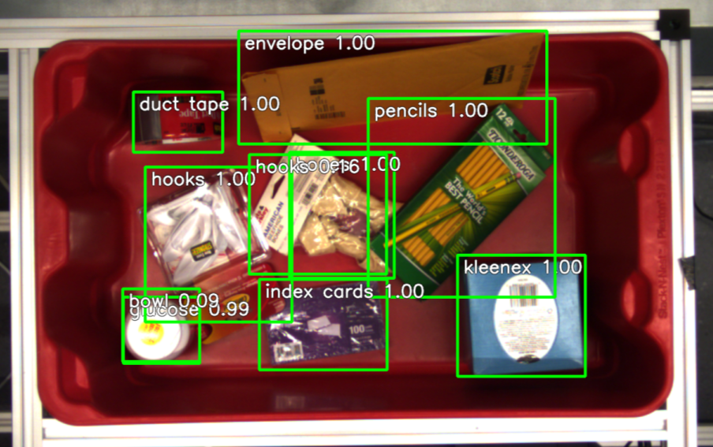
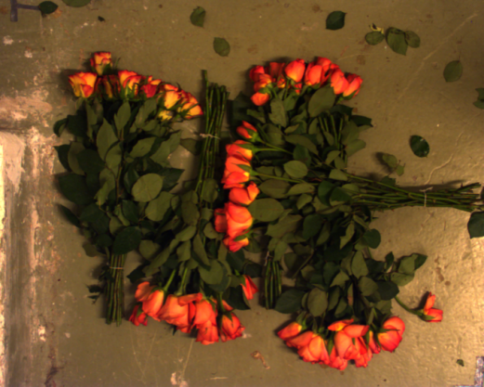
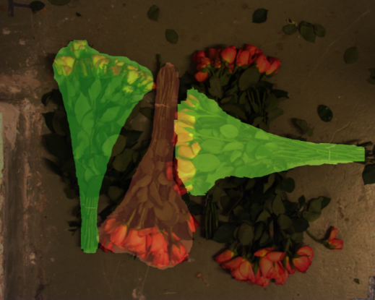
Deep Learning

Slide 9
Object recognition
Pose estimation
Motion planning
System integration

Slide 10
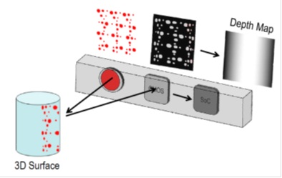
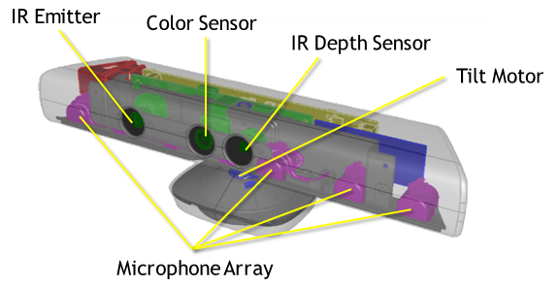
3D vision
Structured Light
Xbox Kinect 1

Slide 11
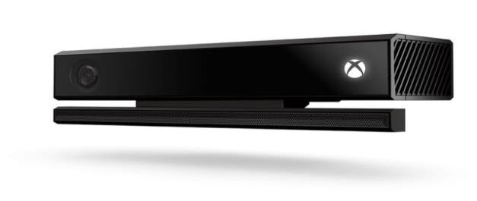
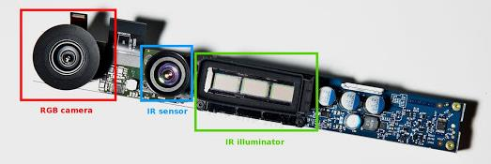
3D vision
Time of Flight
Xbox Kinect 2

Slide 12
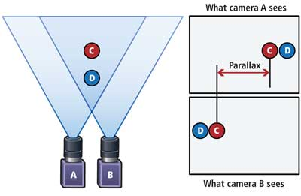
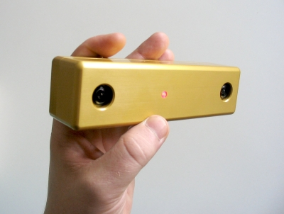
3D vision
Stereo
Normal cameras

Slide 13
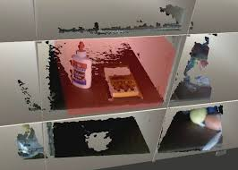
Notes:
“hooguit een half flesje”

Slide 14
Notes:
Success
(Traction,
Popularity,
Fame)

Slide 15
Object recognition
Pose estimation
Motion planning
System integration

Slide 16
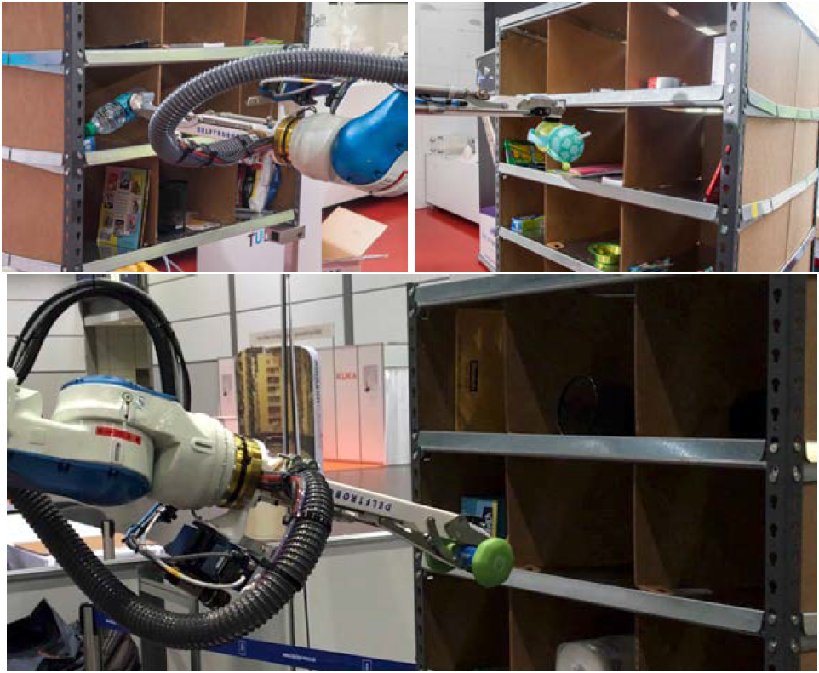
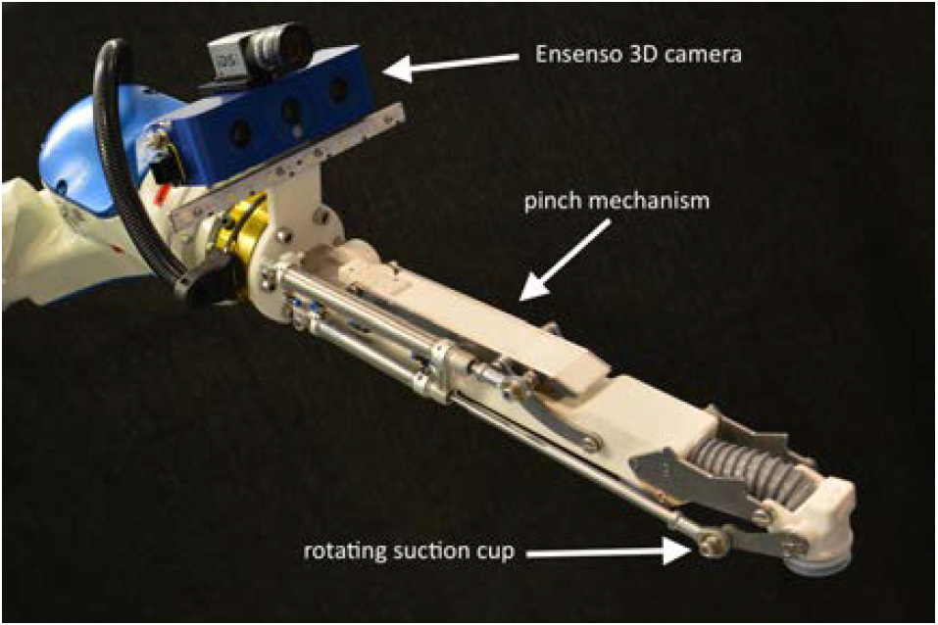
Notes:
Success
(Traction,
Popularity,
Fame)

Slide 17
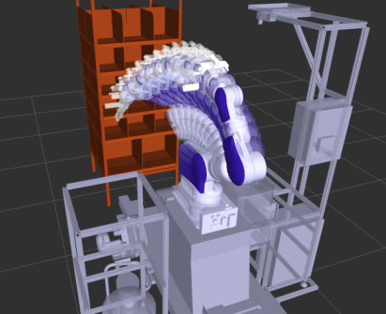
The challenge in motion planning
“The Curse of
Dimensionality”

Slide 18
Object recognition
Pose estimation
Motion planning
System integration

Slide 19
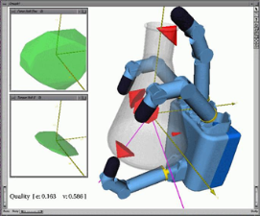
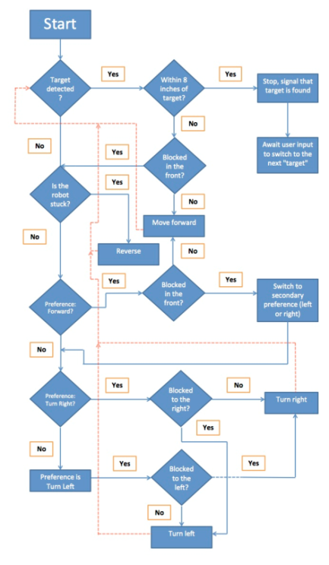
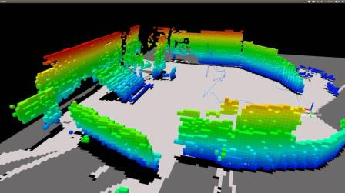
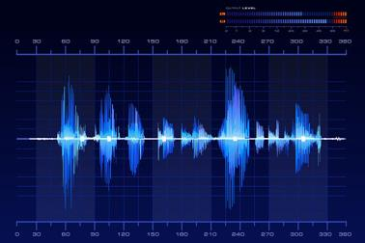
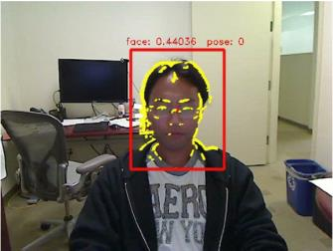
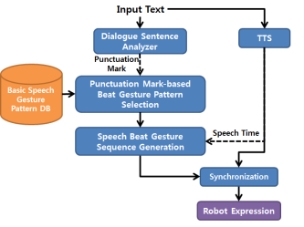
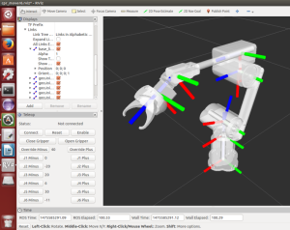

Slide 21
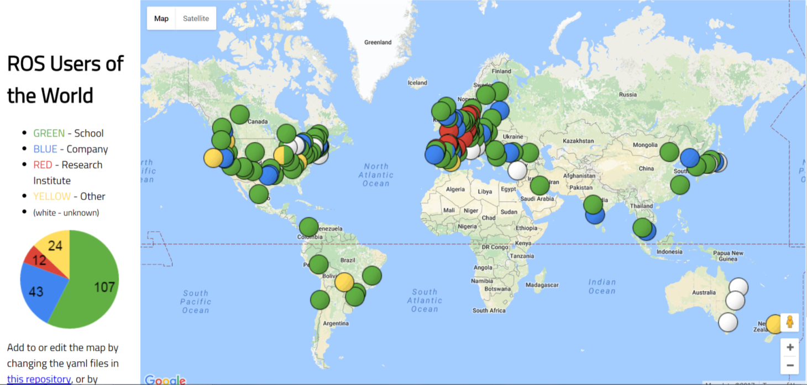
ROS Community

Slide 22
One of the largest open source projects in the world.
ros-users@lists.ros.org subscribers:
2445 (18% increase)
wiki.ros.org users:
5875 (20% increase)
answers.ros.org users:
14,774 (30% increase)
Notes:
Meer dan een half miljoen regels code

Slide 23
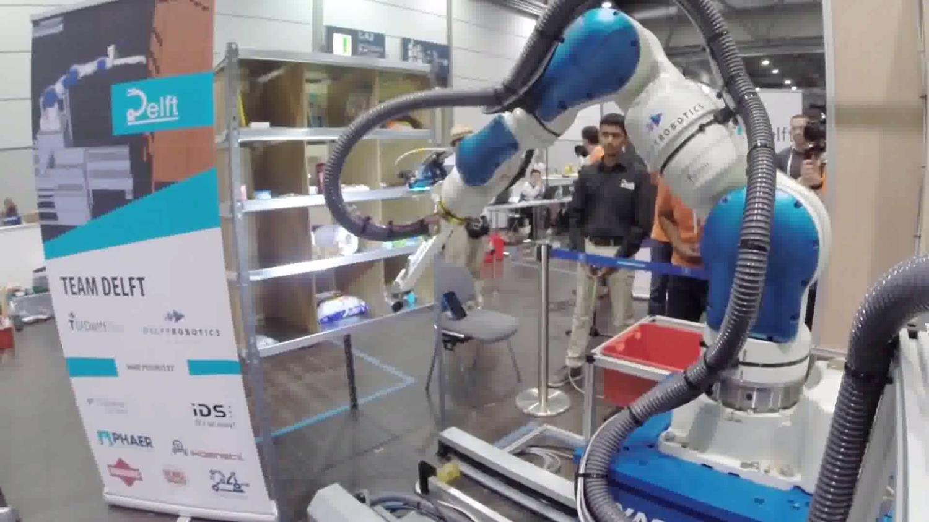
Notes:
Success
(Traction,
Popularity,
Fame)

Slide 24
Object recognition
Pose estimation
Motion planning
System integration
Notes:
“if you want to apply these things, here are a few options

Slide 25
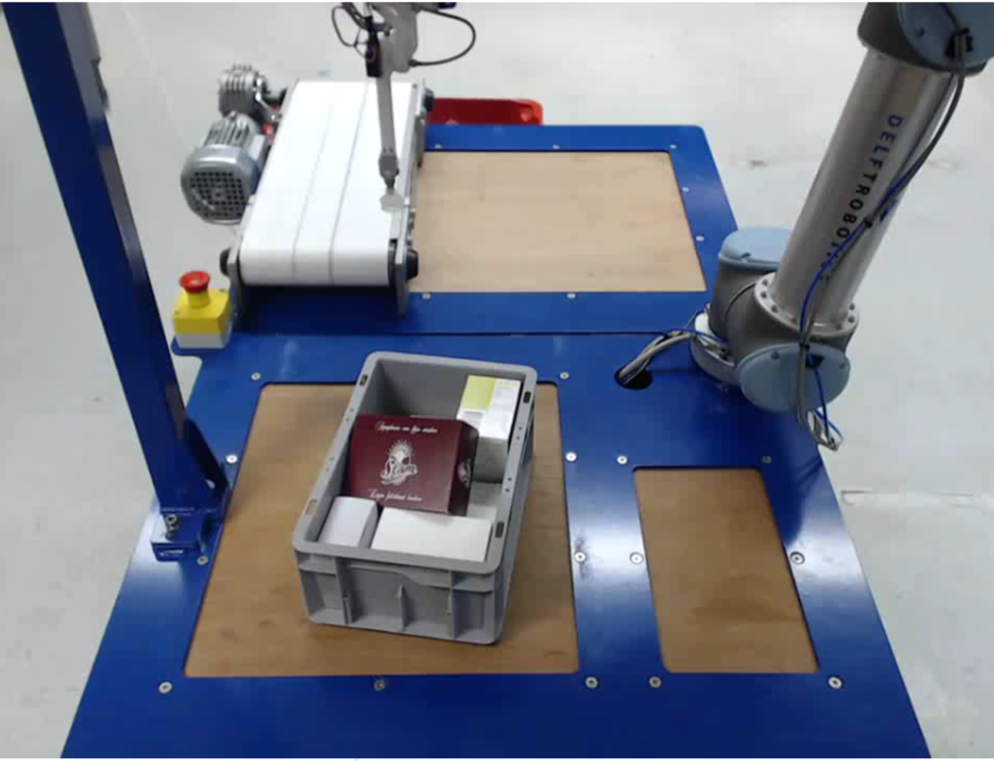
Herbert ten Have
CEO
h.tenhave@
delftrobotics.com

Slide 26
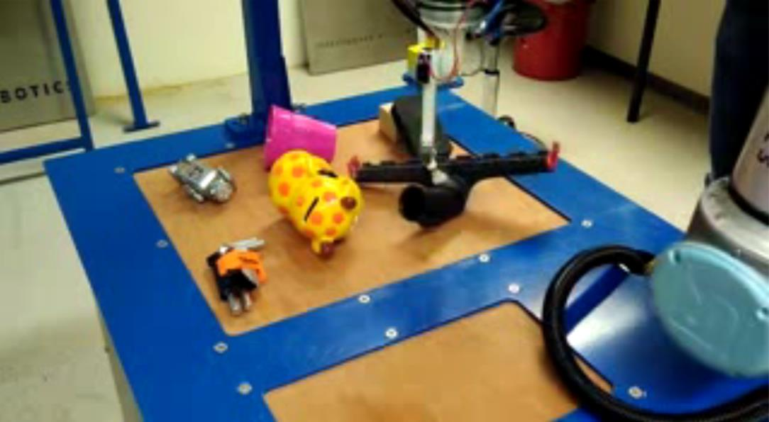
Herbert ten Have
CEO
h.tenhave@
delftrobotics.com

Slide 27
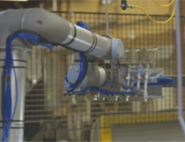
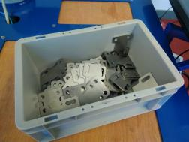
ROSIN
Gijs van der Hoorn
Notes:
Success
(Traction,
Popularity,
Fame)

