Slide 1
Workshop: “Why keep your business in the family?”
Friday March 7th 2014

Slide 2
Erasmus centre for family business
AGENDA
16:05 Presentation Jos Pâques
16:25 Presentation Prof. dr. Hans van Oosterhout
16:45 Interaction
17:05 Wrap-up

Slide 3
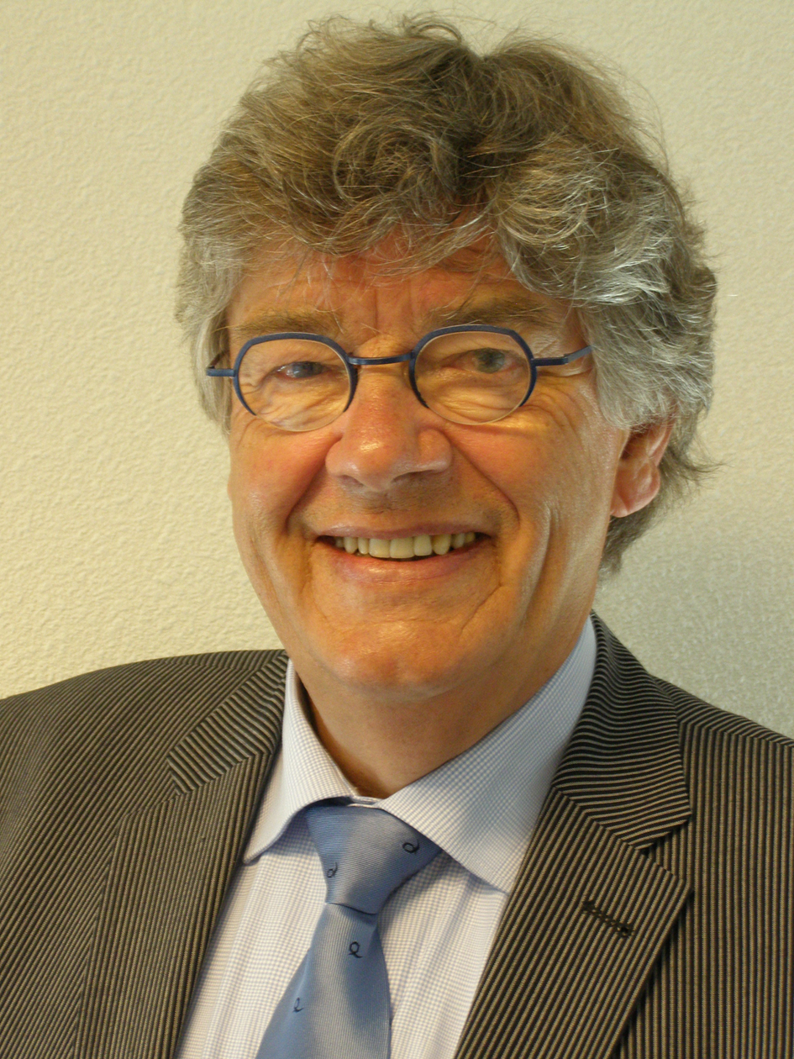
ERASMUS CENTRE FOR FAMILY BUSINESS
Jos Pâques
Founder and major shareholder of Paques Holding B.V.

Slide 4
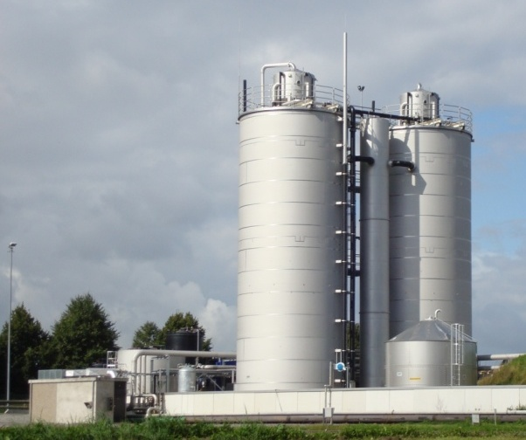
family business
PAQUES
From Silo constructer to Biotechnologies provider
Prepared for Erasmus University
7th of March 2014
Jos Pâques
Founder & Major shareholder

Slide 5
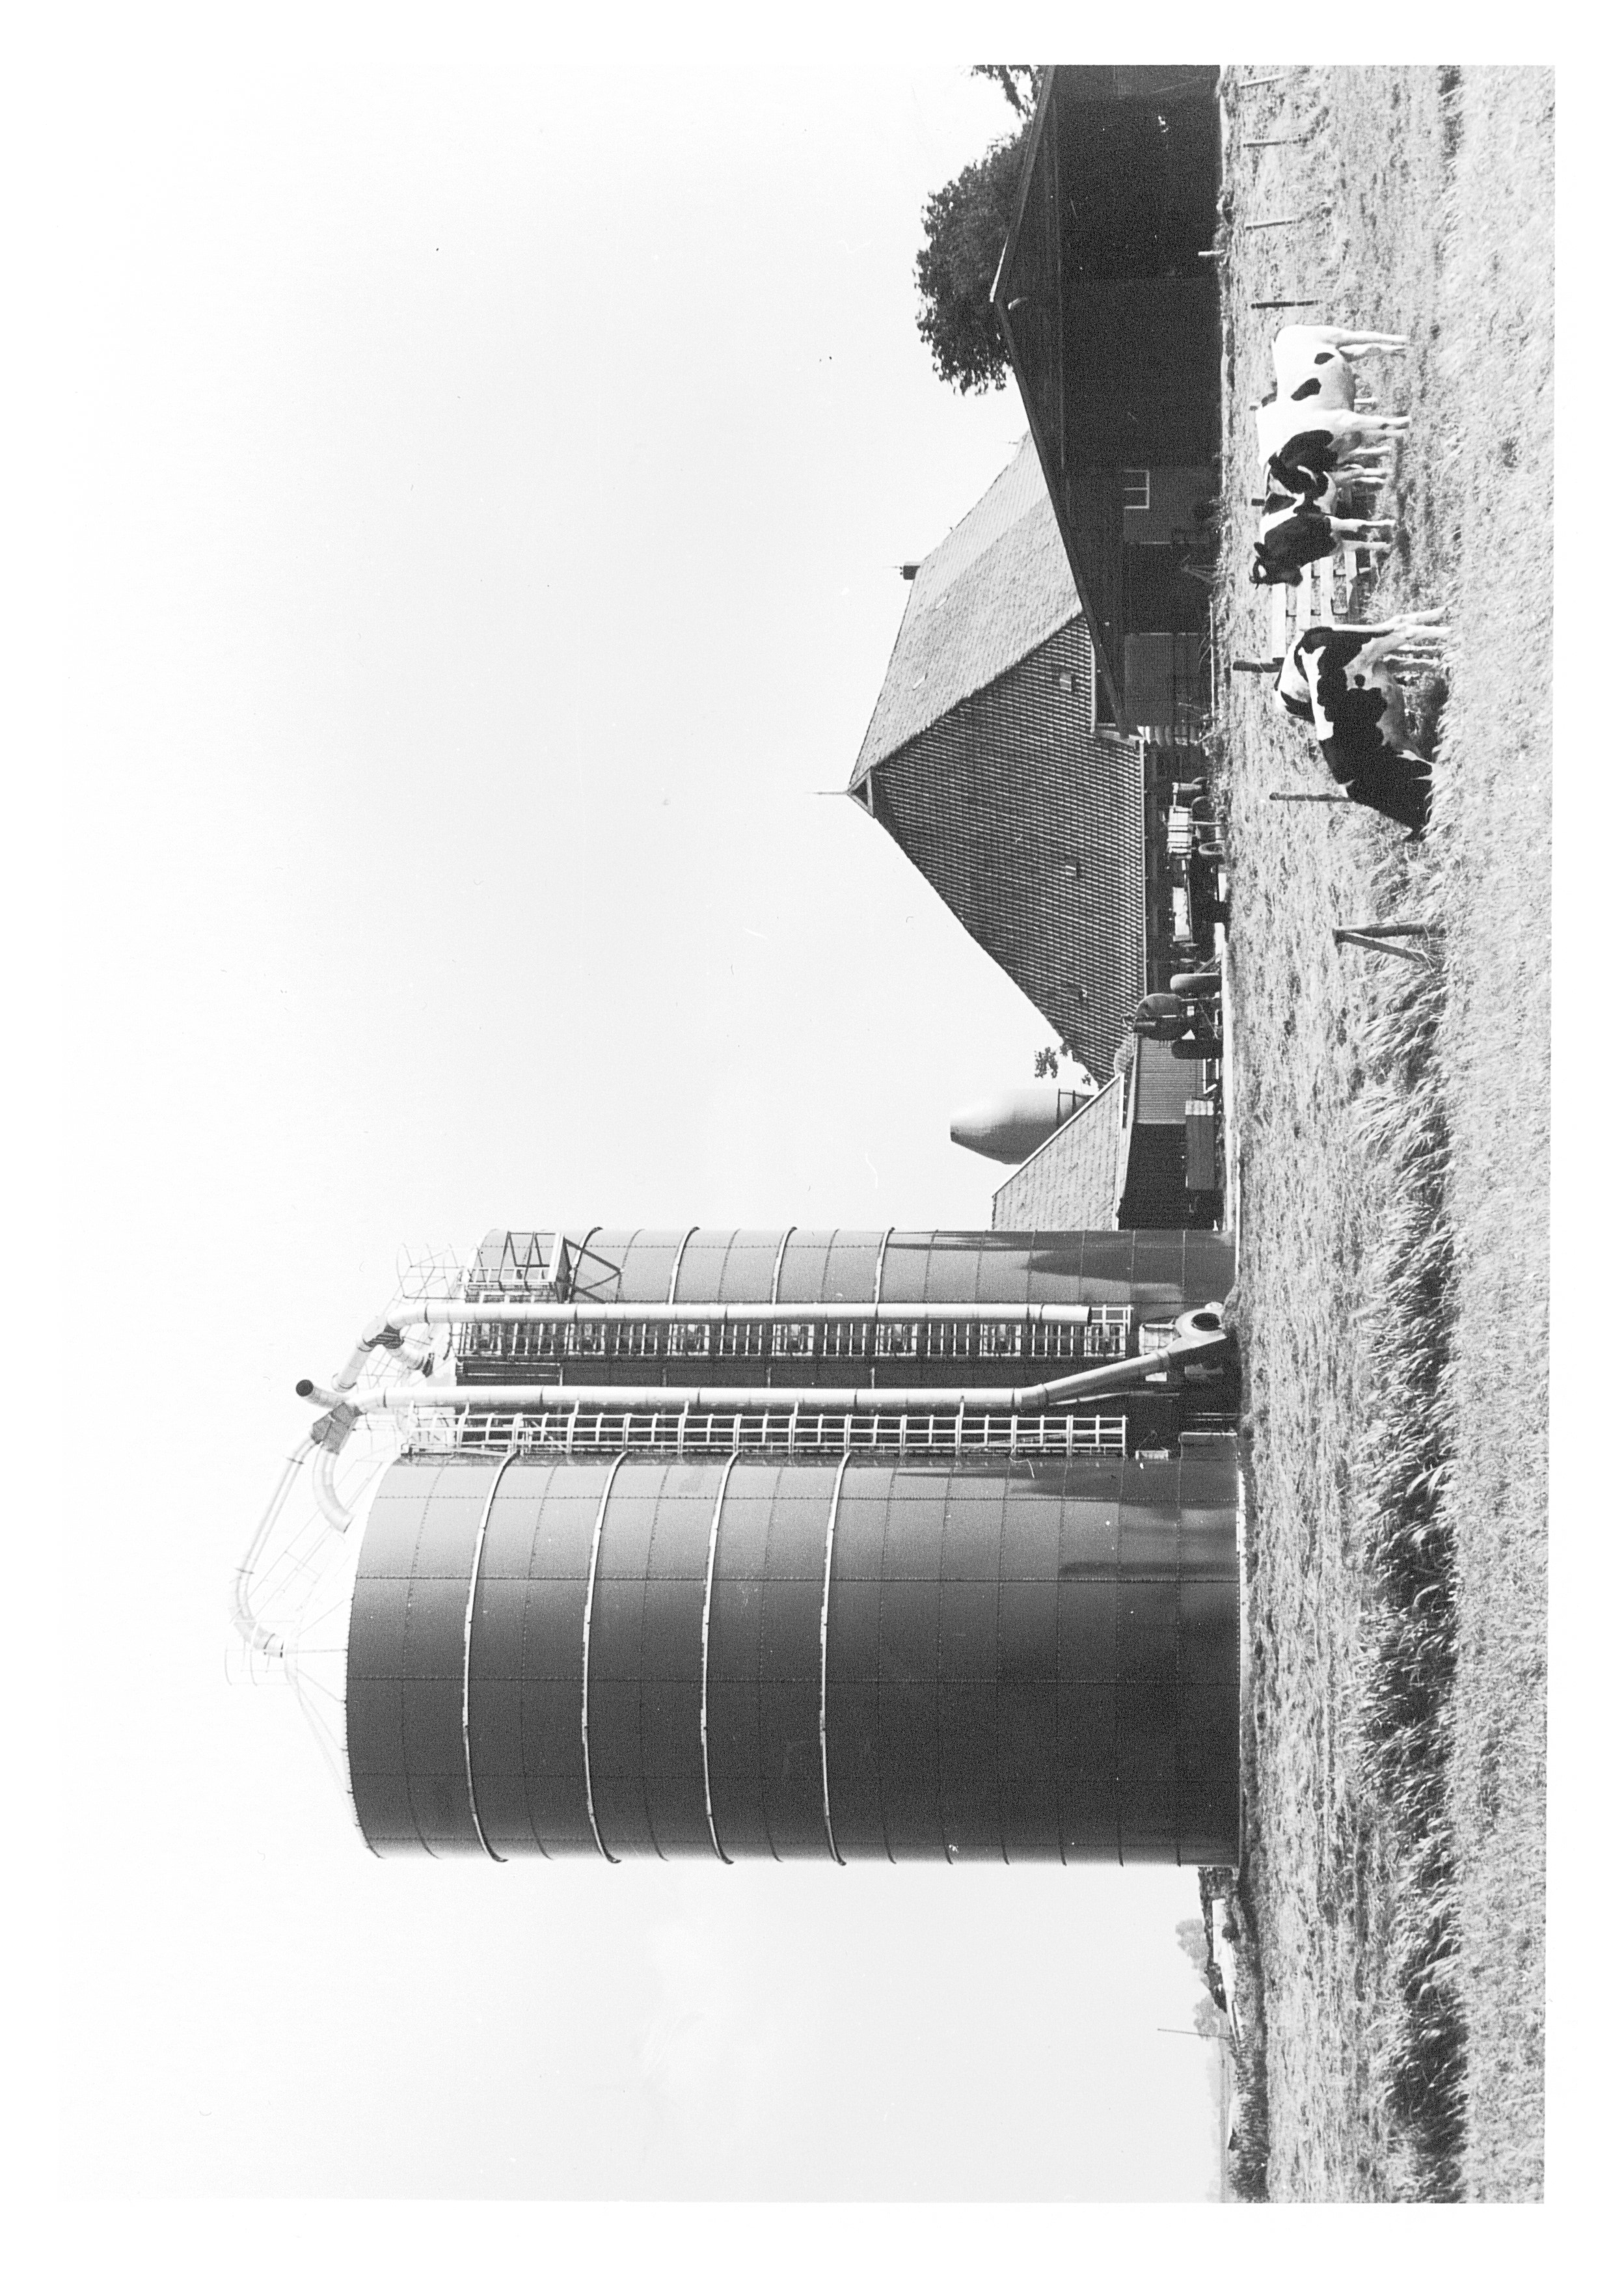
Paques 1968 - 1978
Silo construction for agricultural purposes
Shareholders: Johan Pâques and Jos Pâques

Slide 6

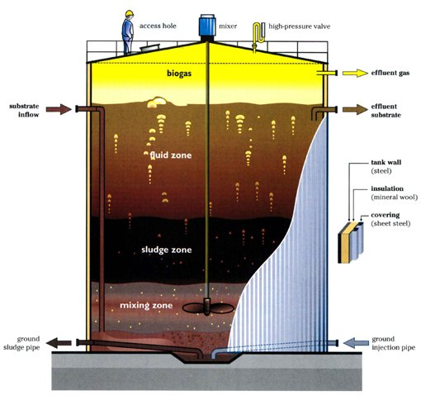
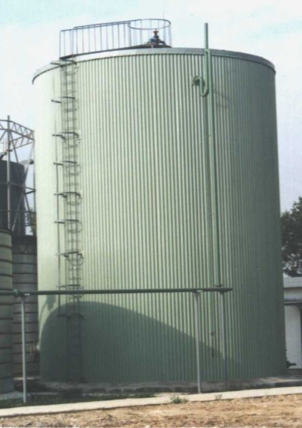
Paques 1978 - 1983
Sludge digestion, biogas installation
50% shareholder, Holec

Slide 7
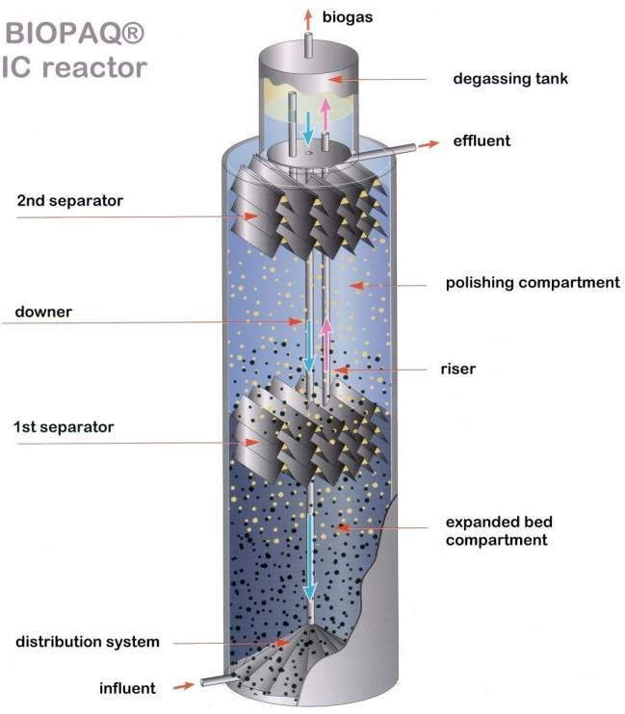

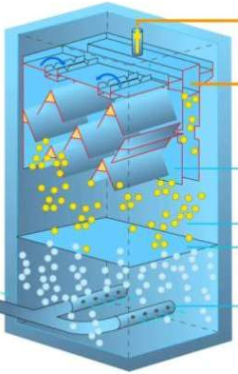
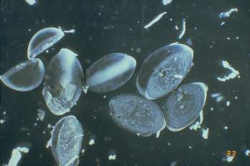
Paques 1983 - 1995
Anaerobic (biological) wastewater treatment
35% shareholder, KLM
BIOPAQ®UASB
BIOPAQ®IC
internal circulation

Slide 8

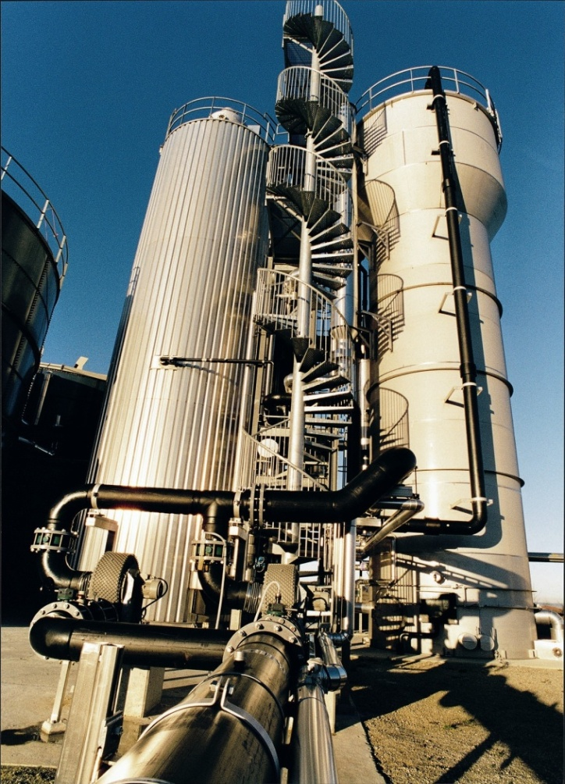
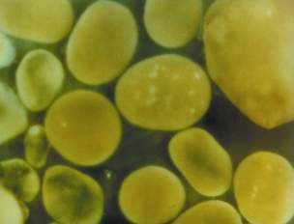
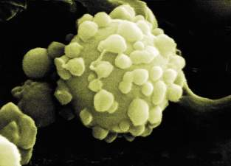
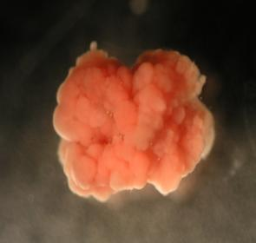
Paques 1995 - 2007
Anaerobic (biological) wastewater & gas treatment
Broadening technologies
50% shareholder, NUON
Upgraded micro organisms from nature
Patented separators
High rate reactors

Slide 9

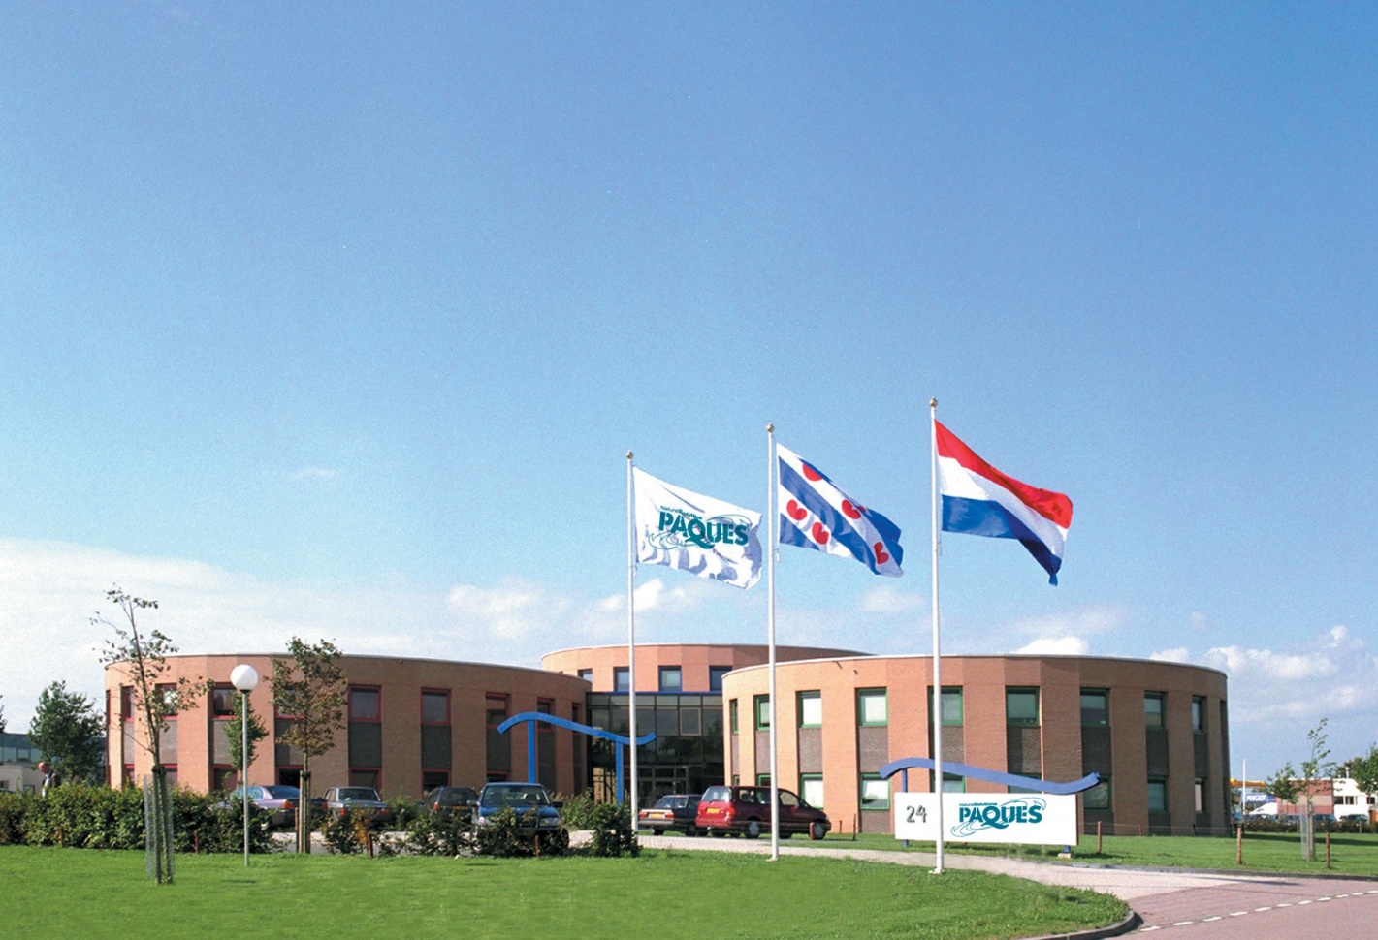

Paques 2007 - today
Worldwide leading in biological wastewater & gas treatment
“Revitalizing resources”+ Broadening technologies
20% shareholder, SKION
Number of employees : 375
Number of Operating Companies : 4 Netherlands, China, India and Brazil + rep office in Canada
Worldwide presence through network of 20 partners
> 1800 reference plants worldwide
> 60 countries
Pulp & Paper, Beer & Beverage, Food, Distilleries, Chemical industry, Metal & Mining, Oil & Gas, Municipalities

Slide 10

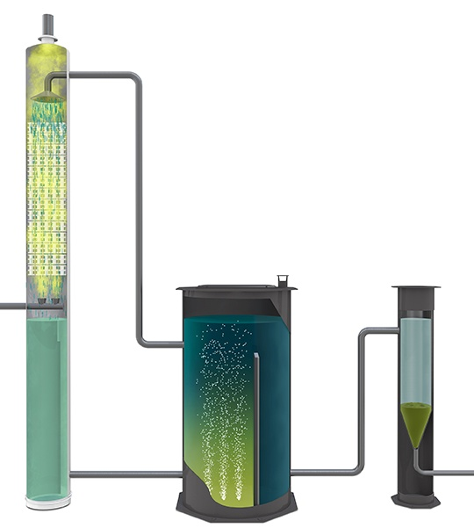

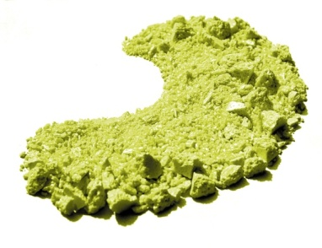
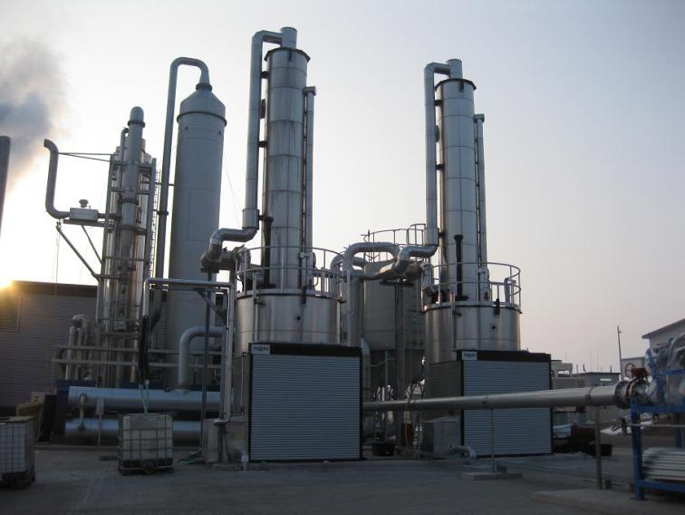
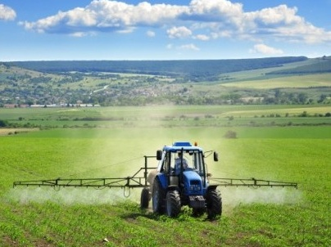

Bioconversion of H₂S to sulfur
THIOSPRAY® Biological Fertilizer
Notes:
Gas dat zwavelwaterstof (H2S) bevat kan effectief worden ontzwaveld met behulp van de THIOPAQ®-technologie.
THIOPAQ® is een biogaswasser of gaswasser en kan worden toegepast voor
biogas (van anaerobe afvalwaterbehandeling, anaerobe afbraak, afvalstortplaatsen, enz.)
ontluchtingslucht met zwavelwaterstof
raffinaderij gas
gassen met zwavelwaterstof in de olie- en gasindustrie en de petrochemische industrie
De THIOPAQ®-installaties variëren van zeer kleine standaardunits tot zeer grote ontwerpen op maat.
Het biogas met zwavelwaterstof komt de absorptiekolom binnen en wordt gewassen met een basische wasvloeistof die de zwavelwaterstof opneemt.
Het biogas verlaat de absorptiekolom aan de bovenkant nagenoeg zonder zwavelwaterstof. De vloeistof met sulfide stroomt naar de bioreactor, waar bacteriën het sulfide oxideren en onder zuurstofbeperkende omstandigheden omzetten in zwavel en loog

Slide 11
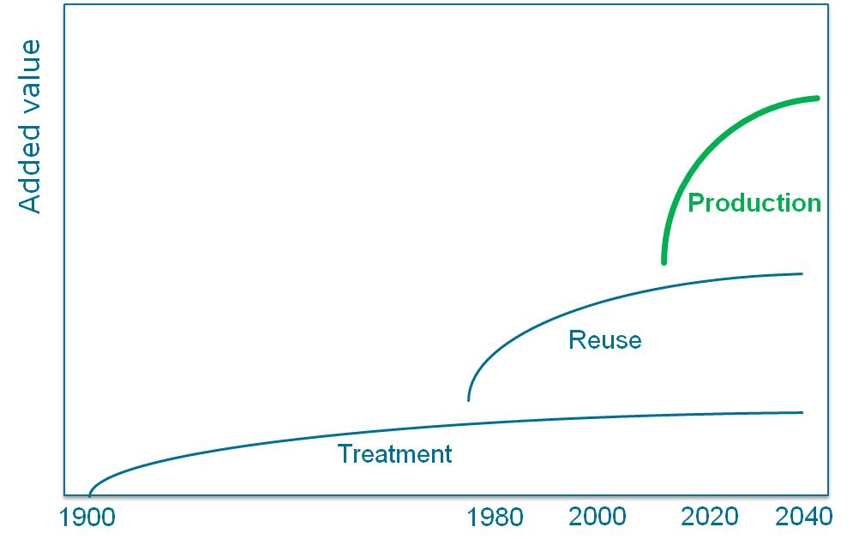
Future perspective
Fatty Acids
Platform
Biopolymers
Alcohols
Biomethane
MCFA
(C6/C8)
e-products
Etc.

Slide 12
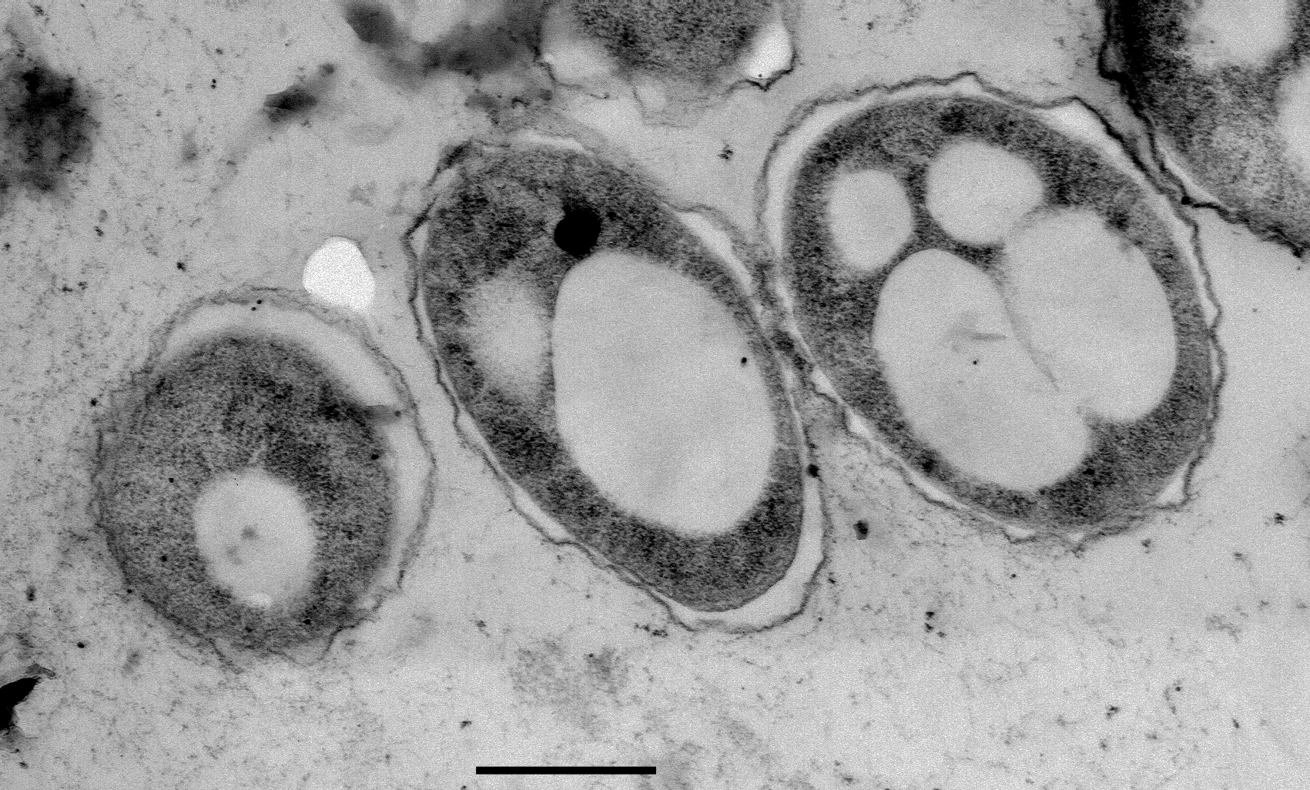



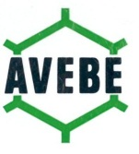





Production of biopolymer (bioplastics)
STW project W2R 2011 – 2015
4 PhD students , 2 Post-doc positions
4 Universities
7 contributing companies
Notes:
In 2012 heeft Paques samen met technologie stichting STW en de Technische Universiteit Delft het project "from Waste to Resource"opgestart met een proefinstallatie in biopolymeren (PHA) bij de produktie faciliteit van Mars in Veghel.

Slide 13

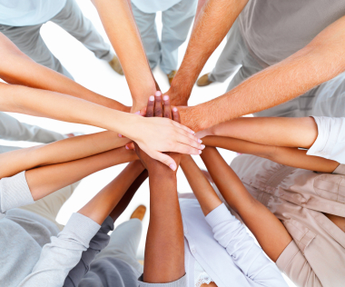
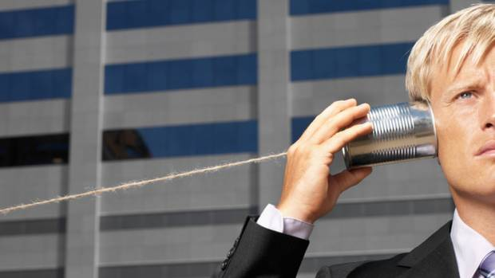

Success factors of Innovation
Notes:
Firstly I would like to mention: Passion, Passion in your work. Or more specifically, Passion to take the challenges we face today in the environment is key for success. If you feel passionate for designing shoes, please design shoes. If you feel passion for animals, please think about which technology can help animals to get a better life. But if you are passionate about the environment, whether it be water, soil or air, this is the field you should go for!
Secondly I would like to mention: Cooperation. To succesfully transfer a laboratory scale process into a full industrial scale solution you need to cooperate with universities, knowledge institutes, your clients but also with other disciplines such as electrical and mechanical engineering, construction and project execution.
Thirdly: listen to the market. Try to understand what the market needs are, not only today but even more important in the future. Market pull is often more important than technology push, however for major breakthroughs you need both!
And finally, you need a bit of luck. Mankind and maybe this is fortunate, is not in the position to control everything, so luck is needed to be successful. But do not let you stop: behind a few successes are many failures, but if you do not start you will never get there anywhere

Slide 14
Thank you
for
your attention

Slide 15
How would an academic think about developing an ownership strategy for the family firm?
Friday March 7th 2014
J. (Hans) van Oosterhout
Professor of Corporate Governance and Responsibility

Slide 16

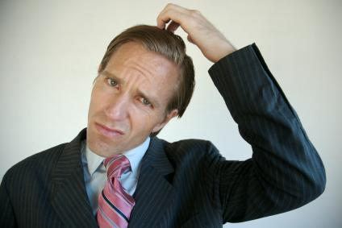
The family firm ownership dilemma
If we continue family ownership, how do we leverage its benefits and reduce its costs?
Should we sell the family firm in part or in whole?
Notes:
This is my agenda for today. In my view, developing an ownership strategy for the family firm essentially evolves around a strategic dilemma that each generation will face, later generations probably more than once.
The fist question of the dilemma is whether we should sell the firm in part or in whole/Whether to continue family ownership.
I will argue that this all depends on the costs and benefits of family firm ownership (compared to other forms of ownership, such as the PLC).
I will provide some foundational insights to help you on your way, after which we will discuss the Prada case, and make a cost benefit analysis of family ownership.
The second question focuses on what needs to be done when if we continue family ownership, and is about the question how to:
leverage the benefits, and to
decrease the costs of family ownership,
We will conclude that this question essentially involves the question how to develop and organize the family of owners in order to fully unleash the value that a business owning family can bring to the firm .
We will discuss the 4 gen Owens family case, and we will break out in groups to work on an ownership plan for a business owning family.

Slide 17
IN ESSENCE, How to maximize:
The benefits of family ownership
The costs of family ownership
Notes:
The questions here are:
Who are the owners, and
why do you think that makes sense (or not)?
Take aways:
Ownership varies (with some forms being dominant in some industries).
In explaining why, an important question is what do the owners bring to the table? (resource dependencies),
And whether the firm could reliably deploy that resource if the suppliers would not be the owners?
Also: ownership changes over time (because of a change in business model and the process and structure of value creation in an industry.

Slide 18

some benefits of family ownership
Notes:
What rights do the owners have over and above the rights of other stakeholders?

Slide 19

A long term PERSPECTIVE

Slide 20
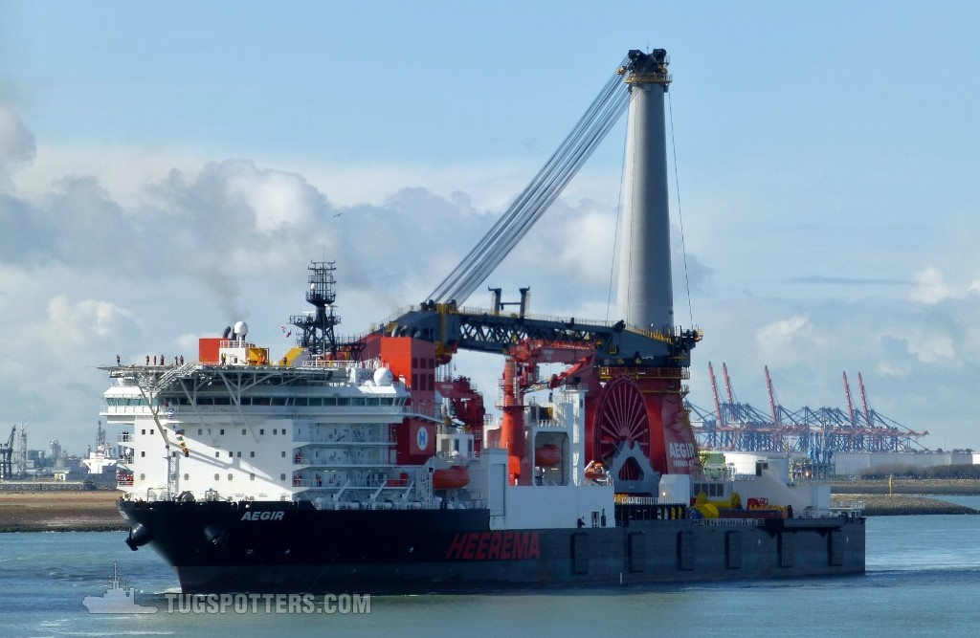
DEDICATED AND Patient capital investment

Slide 21
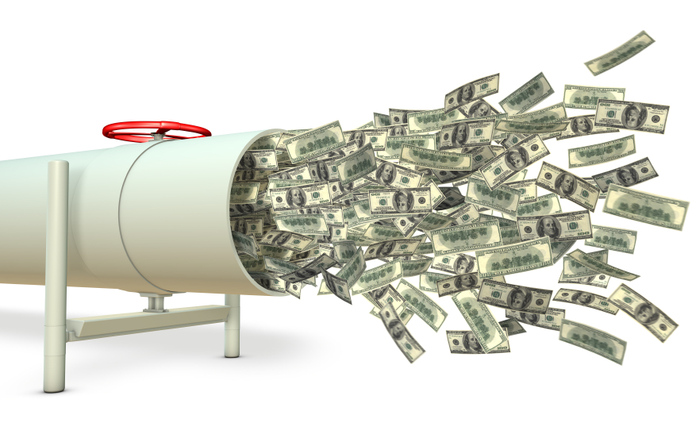
FAMILY OWNERSHIP AS AN ASSET

Slide 22
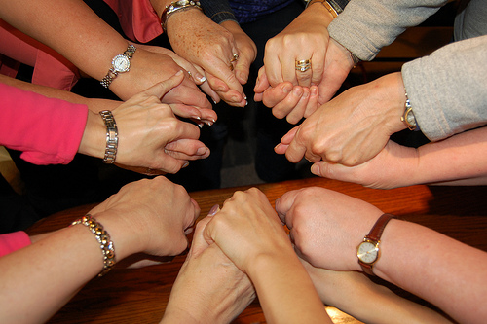
STABLE STAKEHOLDER RELATIONSHIPS

Slide 23

DEDICATED monitoring RELATIONSHIPS

Slide 24

SOCIO-EMOTIONAL RETURNS TO FAMILY OWNERSHIP

Slide 25
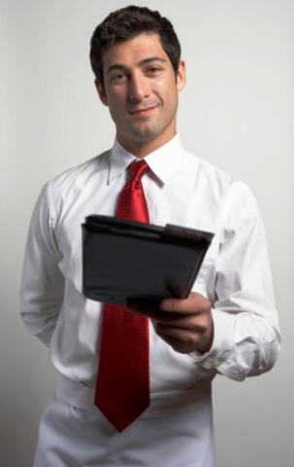
There are also costs to FAMILY ownership….

Slide 26
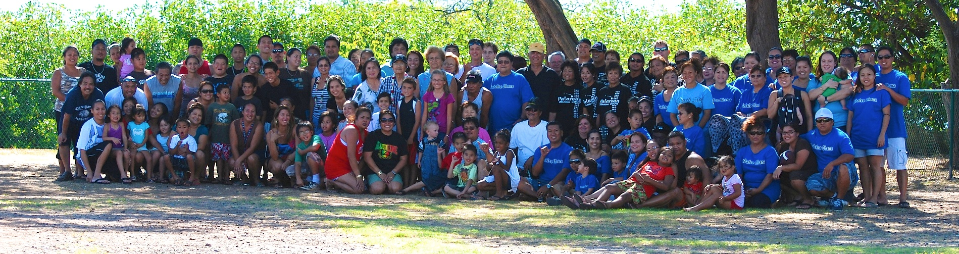
Governance costs: Against The tide of time?

Slide 27
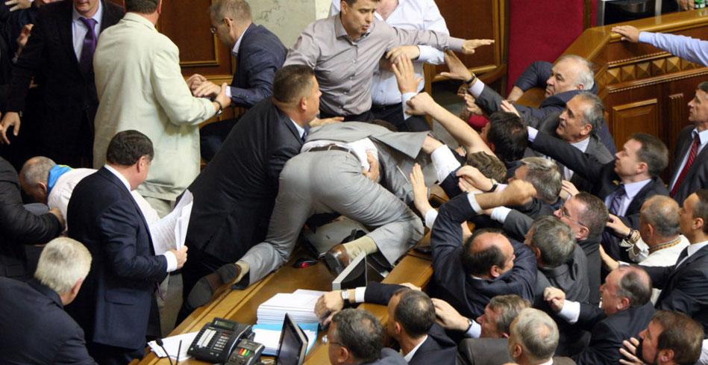
decision making costs

Slide 28
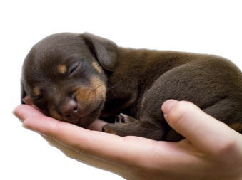
Monitoring COSTS

Slide 29
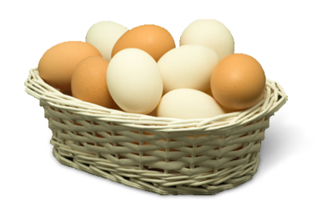
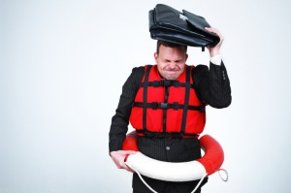
THE COSTS OF INEFFICIENT RISK BEARING

Slide 30
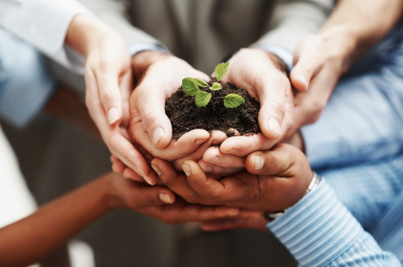
BENEFITS FROM STRATEGIC OWNERSHIP FOREGONE
Other owners can also bring unique or complementary assets to the firm

Slide 31
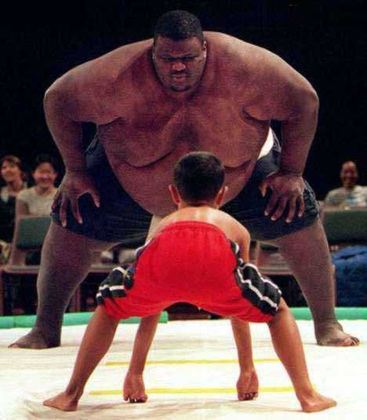
EXPROPRIATION COSTS FOR NON FAMILY SHAREHOLDERS?

Slide 32
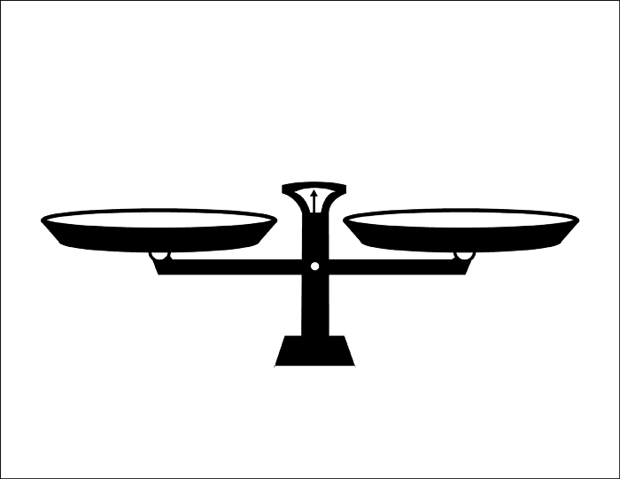
IN SUM:
Benefits
Long term perspective
Dedicated and patient capital
Family ownership as an asset
Stable stakeholder relationships
Dedicated monitoring
Socio-emotional returns for family owners
Costs
Decision making costs
Monitoring costs
The costs of inefficient risk bearing
Benefits from strategic ownership foregone
Expropriation costs for non-family owners

Slide 33
ERASMUS CENTRE FOR FAMILY BUSINESS
  INTERACTION

