Slide 1
Workshop: “Entrepreneurship and Risk Taking in Family Businesses”
Friday March 7th 2014

Slide 2
Erasmus centre for family business
AGENDA
16:05 Presentation Pelle van Walraven
16:25 Presentation Prof. dr. Pursey Heugens
16:45 Interaction
17:05 Wrap-up

Slide 3
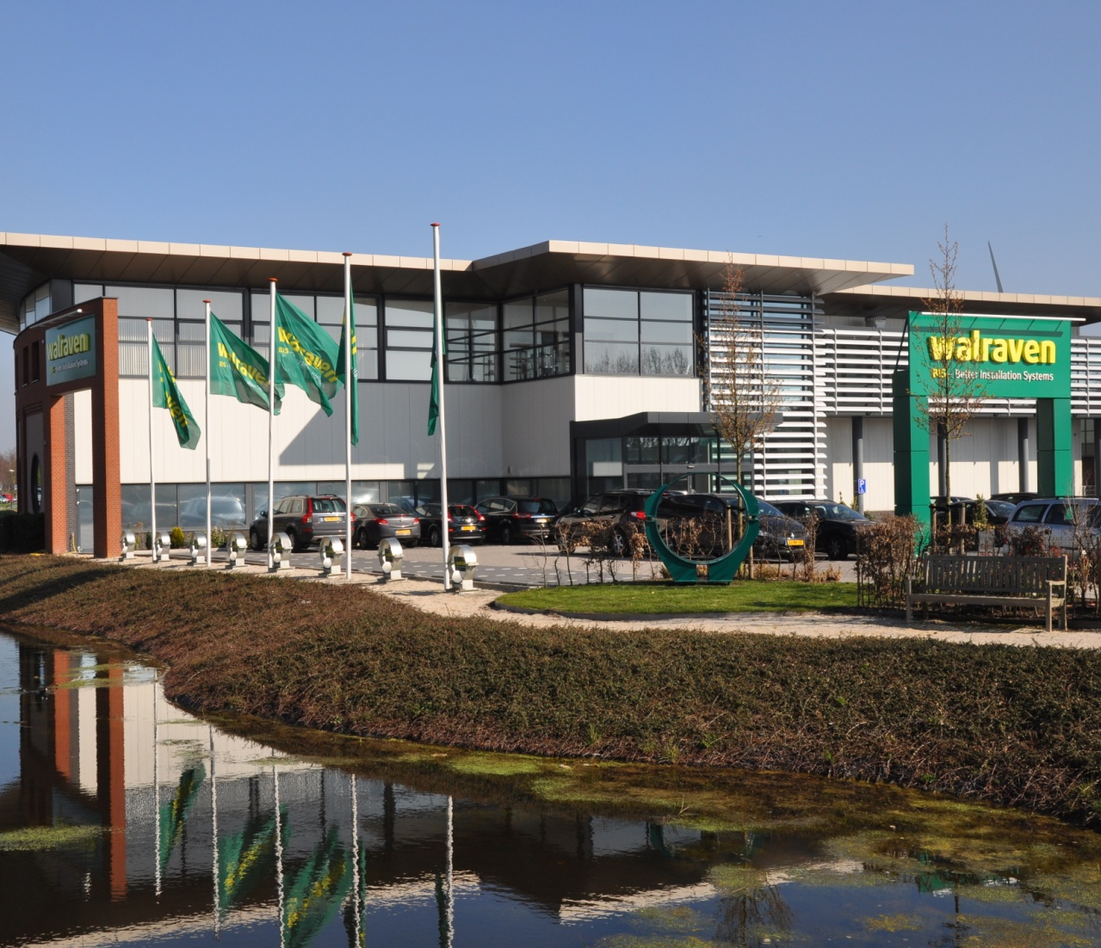

Entrepreneurship and risk taking in family firms
Walraven Group
Know-how, Innovation, Quality, System-thinking, Service
Entrepreneurship and risk taking in family firms RSM 07-03-14

Slide 4
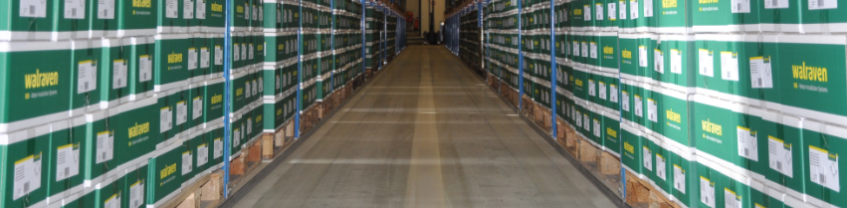
Entrepeneurship and risk taking in family firms
Introduction
Entrepreneurship per generation
Transfer responsibility to the next generation
Lessons learned
Entrepreneurship and risk taking in family firms RSM 07-03-14

Slide 5
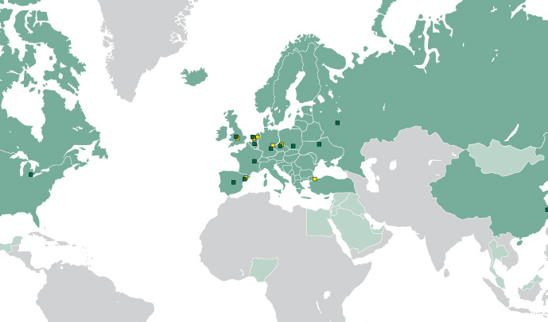

Walraven Today
International family owned company !
Ca. 800 employees worldwide
€ 100 Million + turnover
Ca. 90% of turnover in Europe
Growing fast in emerging markets
Ambitious
Reliable
Long term focus
Know how
Since 1942, more then 70 years of experience !
Entrepreneurship and risk taking in family firms RSM 07-03-14

Slide 6

Our Mission
As Walraven, we provide
comfort and safety to our
customers by supplying them
with our efficient, reliable and
innovative services and
product systems.
It is up to us to keep on doing
this so we can pass this
responsibility on to future
generations.
Pass responsibility
on to future generations
Provide
Comfort & Safety
Supply efficient, reliable, innovative services & product systems
Entrepreneurship and risk taking in family firms RSM 07-03-14

Slide 7

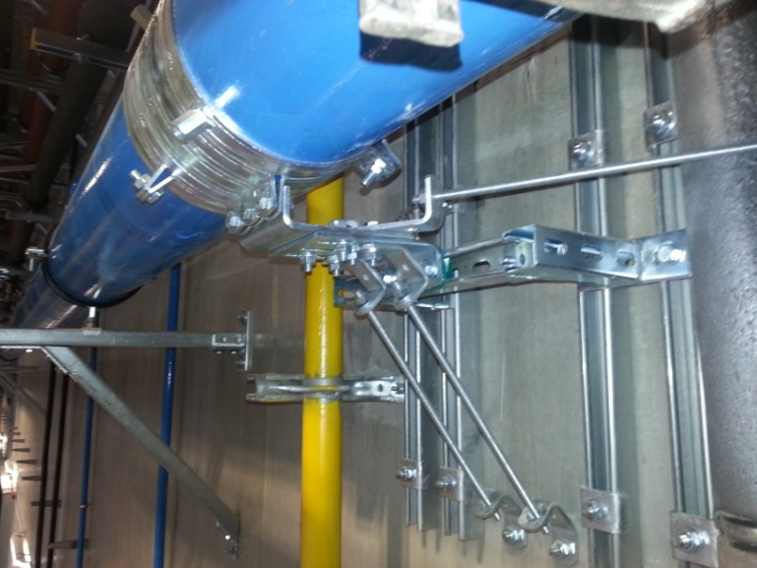
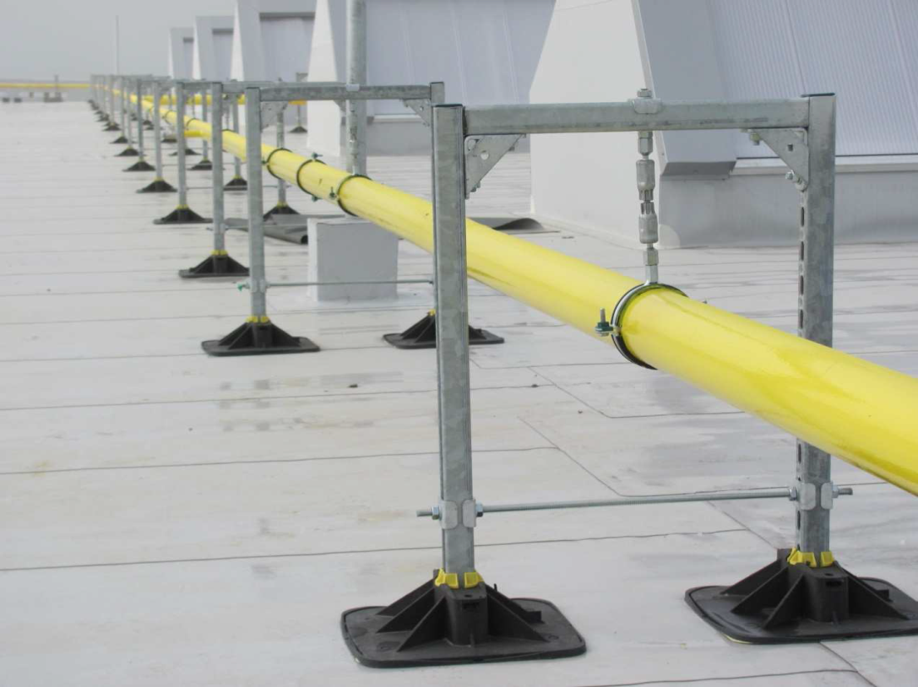
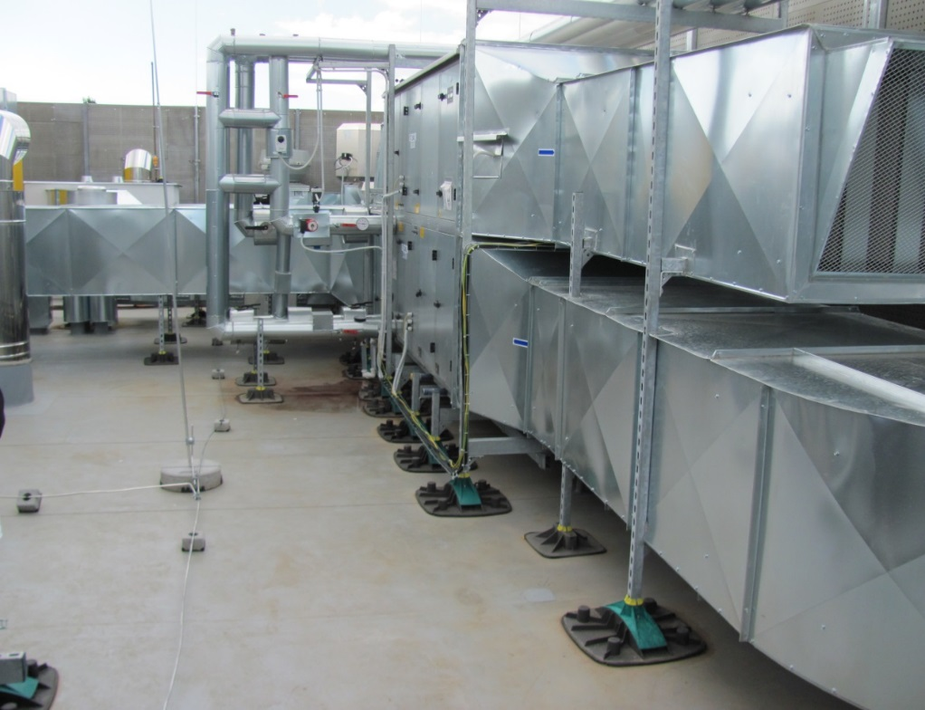
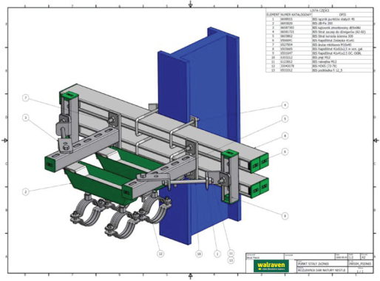
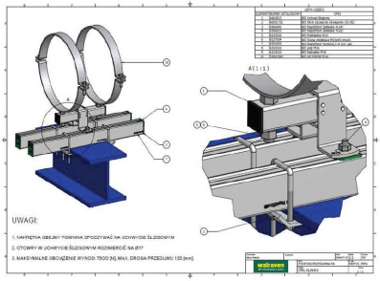
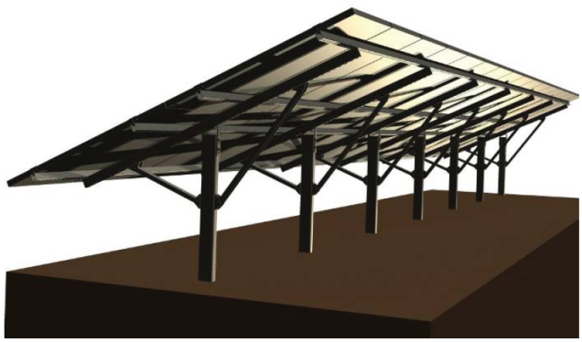
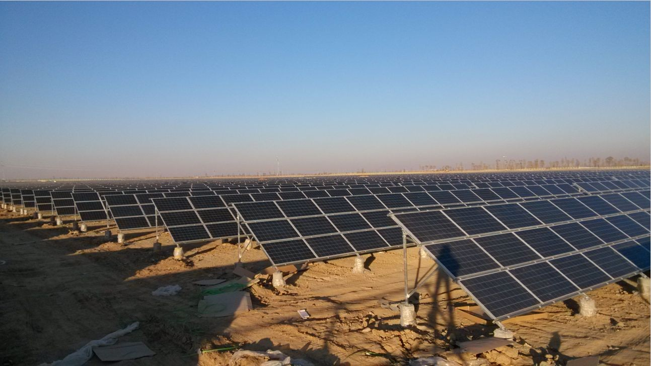
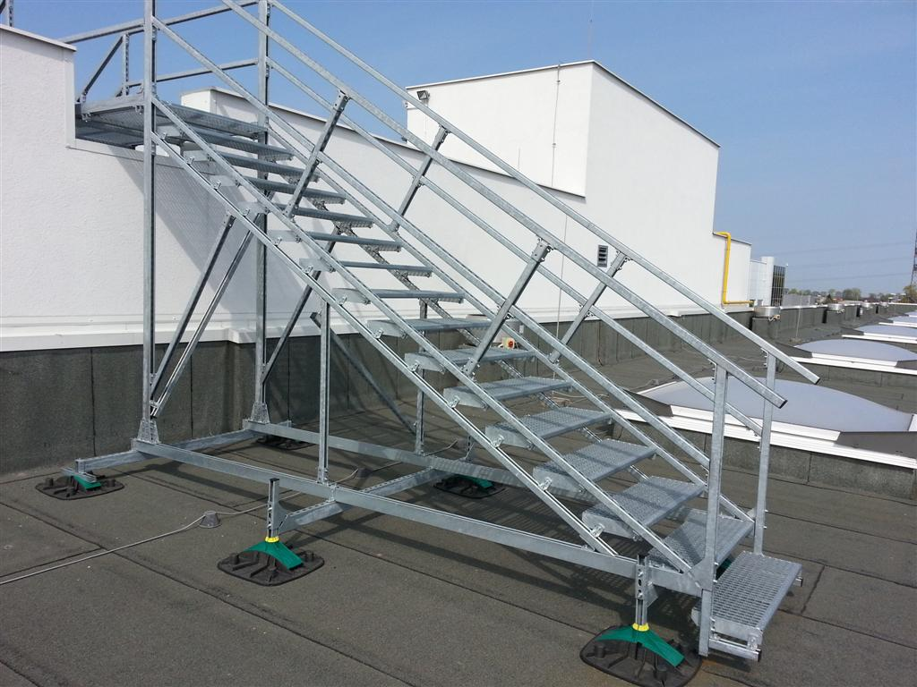
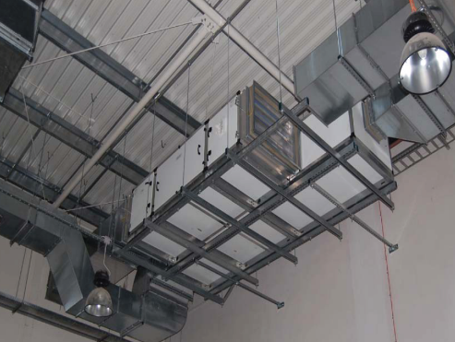
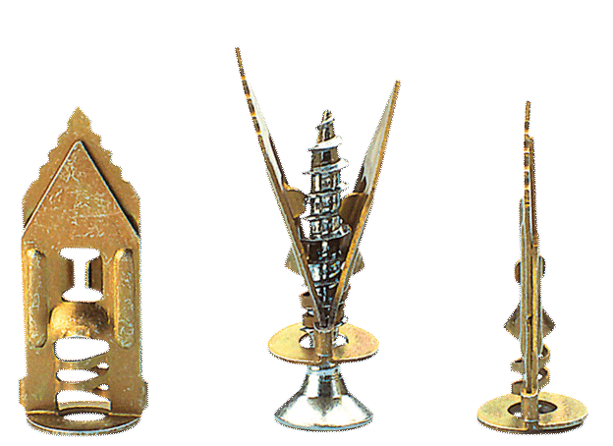
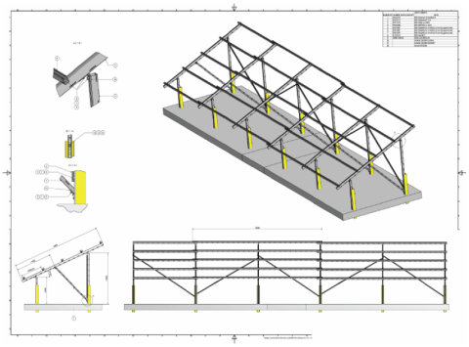
BIS
Fixing systems
Entrepreneurship and risk taking in family firms RSM 07-03-14

Slide 8

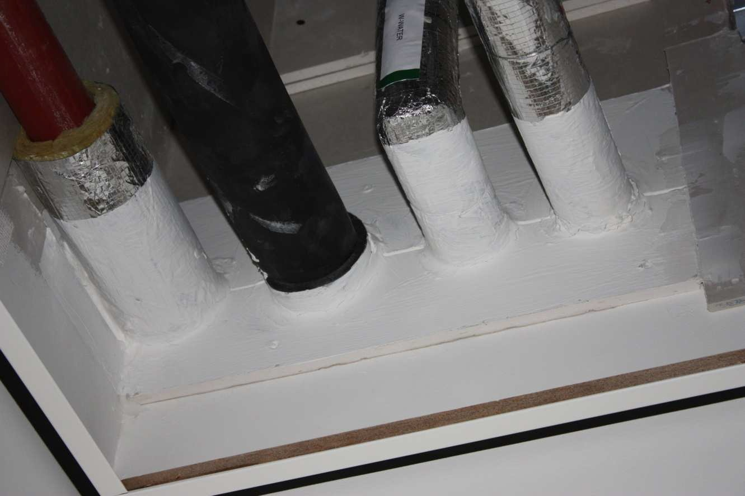

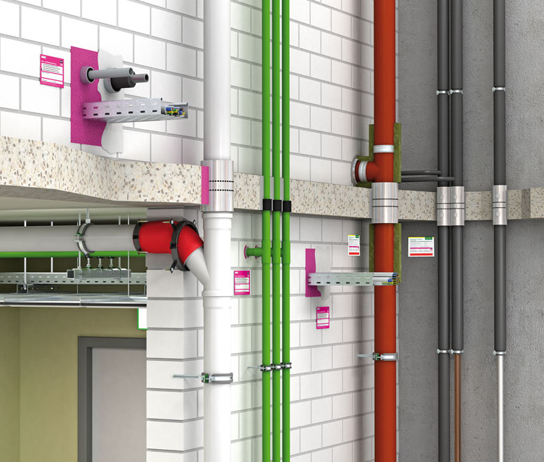
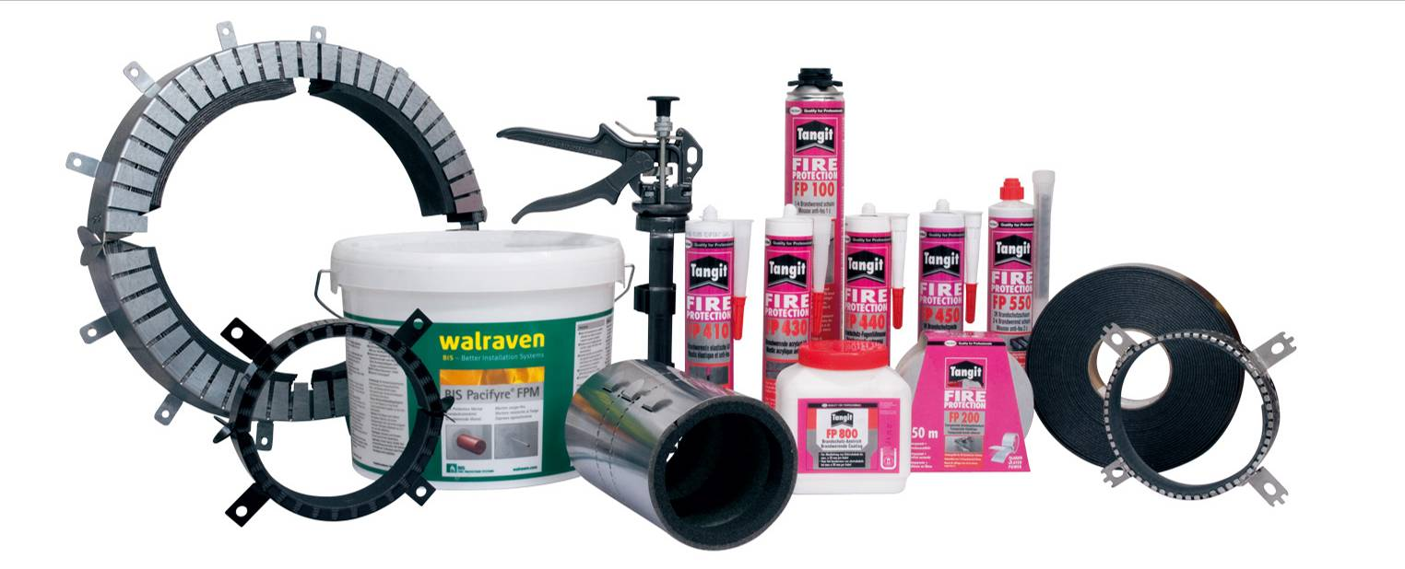
BIS
Fire protection systems
Entrepreneurship and risk taking in family firms RSM 07-03-14

Slide 9


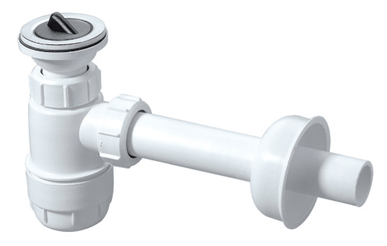
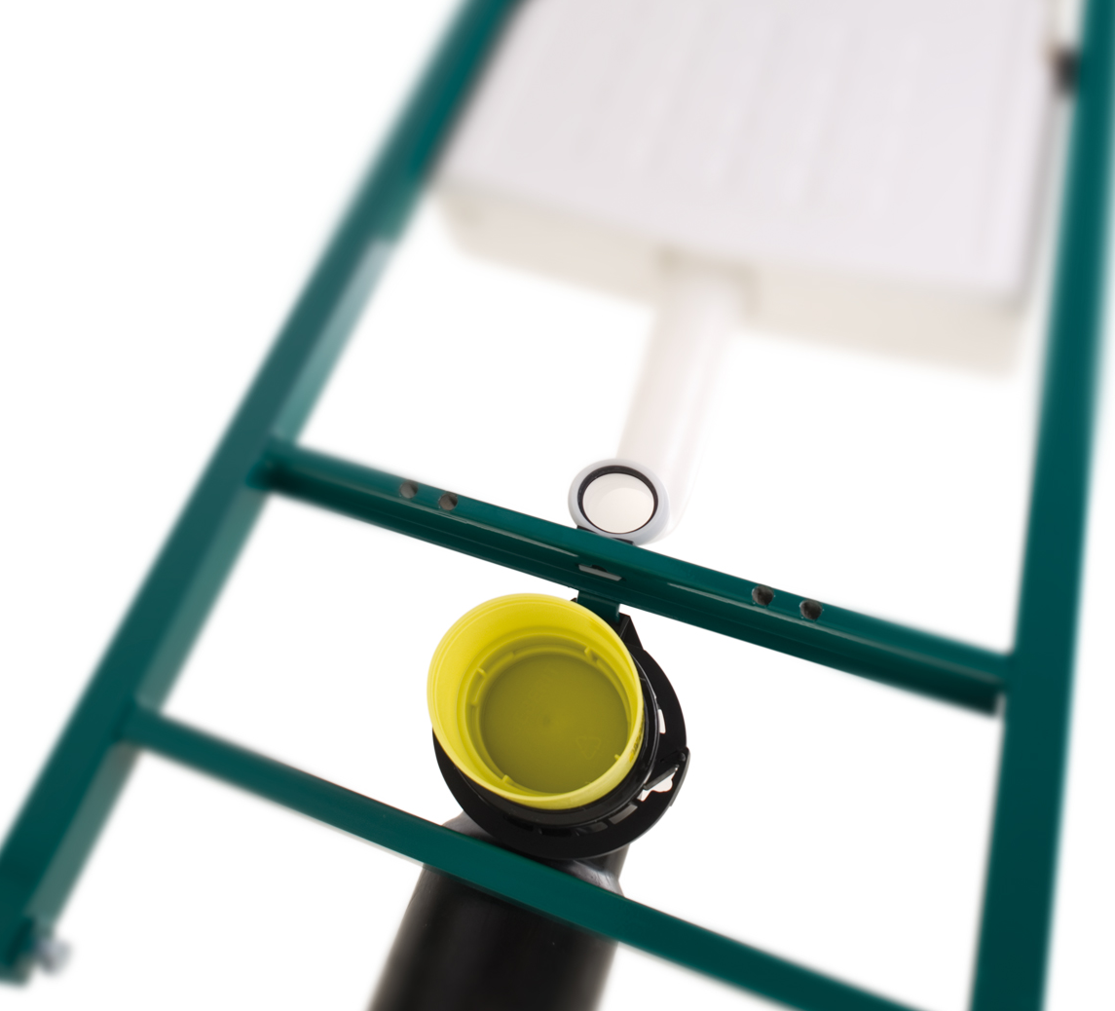
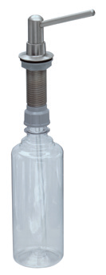
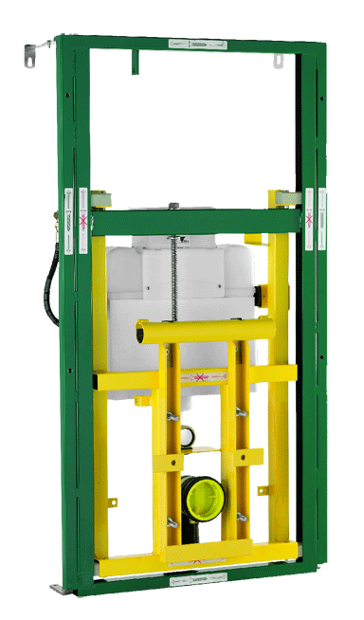
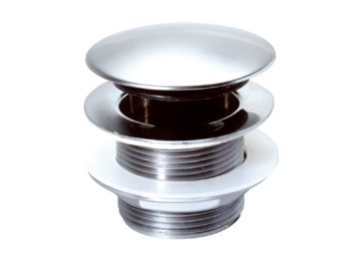
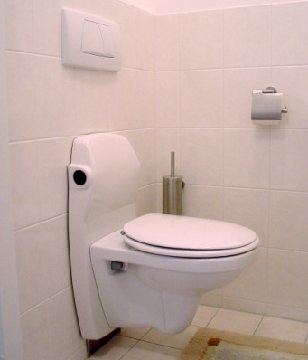
BIS
Sanitary systems
BIS Vario®
High/low adjustable WC
Entrepreneurship and risk taking in family firms RSM 07-03-14

Slide 10
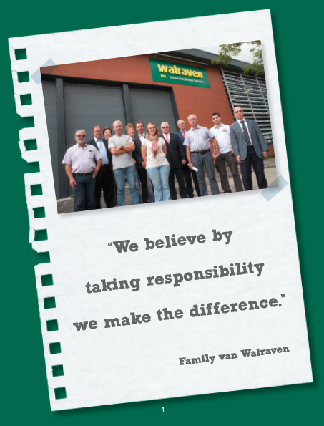
Transfer responsibility to the next generation
Started 5 years ago
  Building network (f.e. Fbned)
  Dialogue with all stakeholders
    Family
    Owners
  (certificate holders, family)
    Supervisory board
    Statuary directors
    Management
    Employees
Management development
Corporate governance
  Legal, tax
  Company statutes
  Structure, strategic clock
Continues corporate dialogue
Entrepreneurship and risk taking in family firms RSM 07-03-14

Slide 11
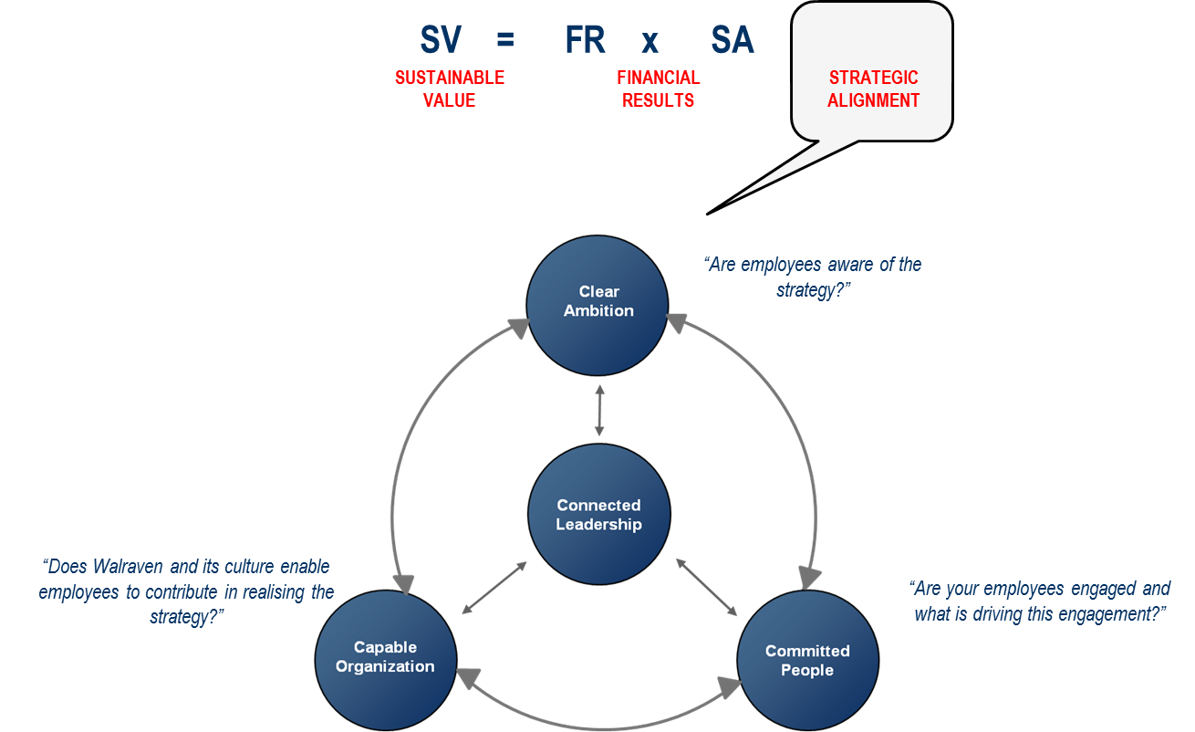
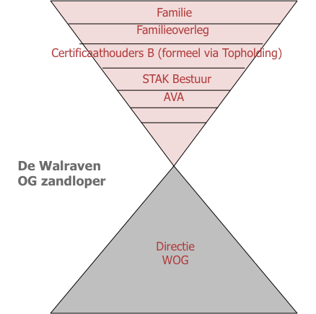
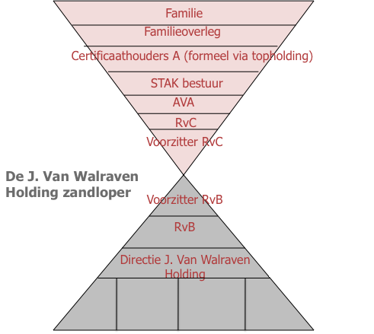
Transfer responsibility to the next generation
FAMILIESTATUUT
FAMILIEOVERLEG
FAMILIEOVERLEG
Entrepreneurship and risk taking in family firms RSM 07-03-14

Slide 12
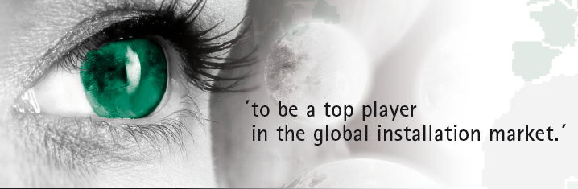

Lessons learned
Take your time
Build a network
Open minded
Chose what feels right for you !
Find your balance between Rationality <-> Emotions Entrepeneurship <-> Management
Continuous dialogue
Leadership
Entrepreneurship and risk taking in family firms RSM 07-03-14

Slide 13
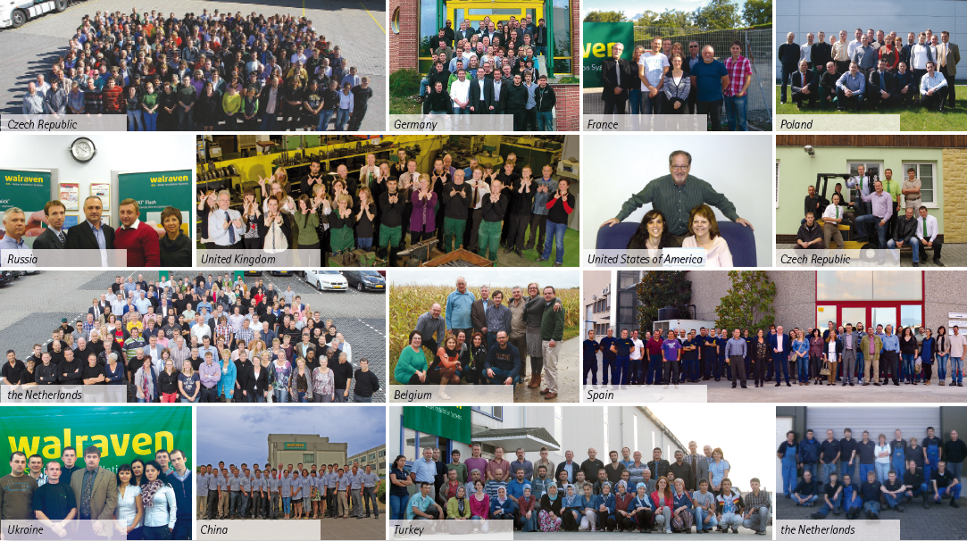
We are your partner in the global installation market !
Thank You !
Walraven Group
Know-how, Innovation, Quality, System-thinking, Service
Entrepreneurship and risk taking in family firms RSM 07-03-14
Notes:
Explanation Our future & Strategy 2020

Slide 14
Entrepreneurship and Risk Taking in FFs
Friday March 7th 2014
Pursey Heugens
Professor of Organization Theory, Development, and Change

Slide 15
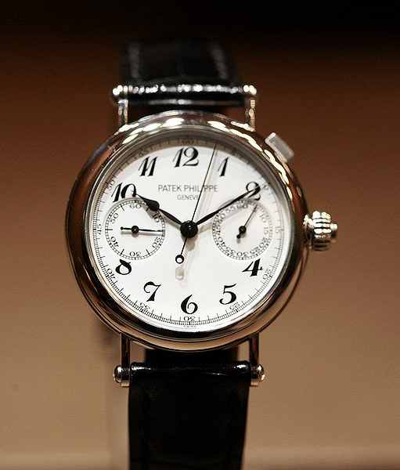
A sensitizing exercise

Slide 16
A sensitizing exercise
Suppose you owned a beautiful watch – one you are really proud of.
One day, you are out partying with your friends, and when you wake up the next morning, you realize you lost it.
What emotions are you likely to experience?

Slide 17
A sensitizing exercise
Now suppose you inherited – through your father – your granddaddy’s watch – one he was really proud of.
One day, you are out partying with your friends, and when you wake up the next morning, you realize you lost it.
What emotions are you likely to experience?

Slide 18

Issues surrounding leadership transitions
The stylized facts surrounding leadership transitions in family firms are unnerving:
  First generation family firms are decidedly more profitable than non-family firms, but second generation firms lose this advantage entirely;
  Leadership transitions are an important cause of family firm failure.

Slide 19
FF survival after leadership transitions
Source: Family Business Institute (http://www.familybusinessinstitute.com)

Slide 20
What causes these firms to fail?
Profound changes in strategy and governance as the firm transitions from predecessor to successor generation.

Slide 21
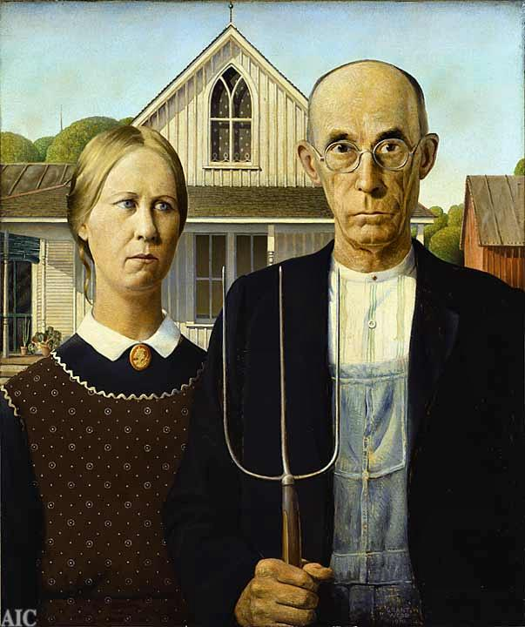
First generation leaders
A “puritan” ethos seems to drive first generation family firm leaders:
  They pay out far less dividends than other public firms;
  They rather reinvest corporate proceeds in research and development;
  They work extremely hard – and successfully so – to make their firms outperform others.
In sum, first generation leaders prioritize the success of the FF over their own welfare.

Slide 22

second generation leaders

Slide 23
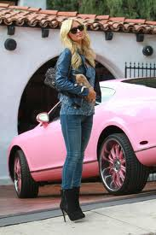
second generation leaders
Second generation family firm leaders appear to have largely lost this ethos, as they:
  Make far higher dividend payouts;
  Substantially lower R&D expenditure;
  Are risk-averse rather than risk-prone;
  Seek to diminish outside control over the firm.
Let’s look at these decisions in turn:

Slide 24
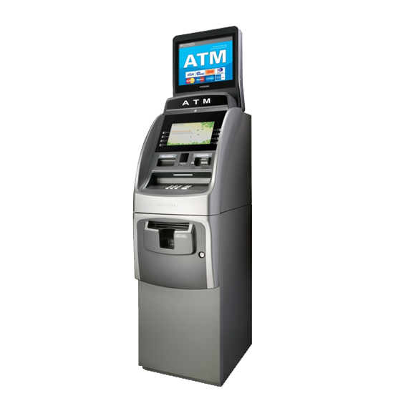
Dividend payouts
It appears that second generation leaders tend to see the family firm as one large ATM machine;
However, withdrawing cash from the firm comes at a steep price: loss of competitiveness.

Slide 25
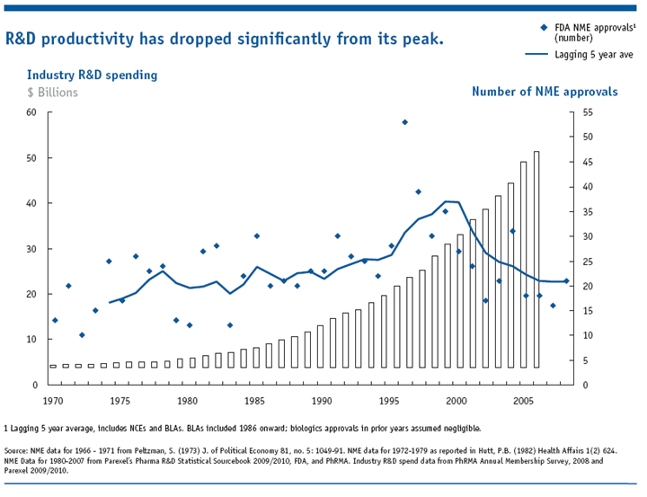
R&D expenditures

Slide 26
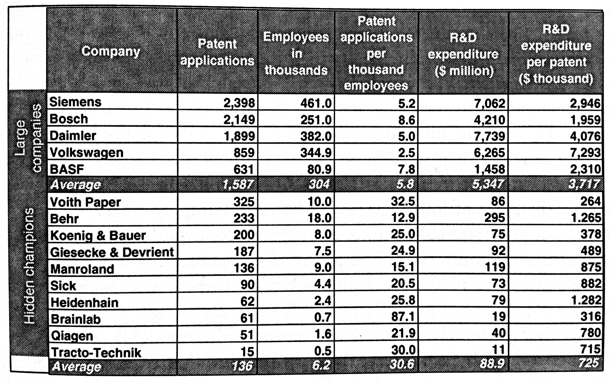
Who is beating the trend?

Slide 27

R&D expenditures
Why are smaller (family) firms so good at R&D?
  Less overhead;
  Closeness to the customer;
  Top management involvement in innovation process;
  Long-term vision is compatible with continuous improvement philosophy and process R&D.
By reducing R&D spending, second generation leaders surrender one of their most powerful advantages!

Slide 28
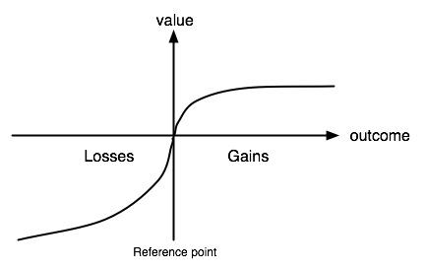
Attitude towards risk

Slide 29
Attitude towards risk
First generation
  Does not experience small losses as an enormous setback
  Is motivated by the prospect of greater gains
  Overall: makes decisions in expansion mode
Second generation
  Scared off by small losses of personal wealth
  Is already quite content with minor gains to personal wealth
  Overall: makes decisions in conservation mode

Slide 30

Corporate governance
A set of principles and mechanisms that, through their implementation, determine the balance of power between all corporate constituents;
First generation family firms strike a reasonable balance between inside interests (the family) and outside interests (non-family workers, blockholders, and minority investors).

Slide 31

Corporate governance
In the second generation, the balance of power shifts dramatically towards insiders;
As compared to first generation leaders, second generation leaders are more likely to:
  Adopt dual class shares to secure their control over the firm;
  Replace thrifty debt with lazy equity;
  Buy out external (non-family) blockholders.

Slide 32
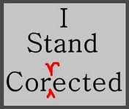
Corporate governance
As a consequence of all these protective measures, second generation leaders are less frequently pressured, corrected, and spurred on by outsiders than first generation leaders

Slide 33
conclusion
To survive generational transitions, FFs must be led by entrepreneurs, not by stewards or custodians.

Slide 34
ERASMUS CENTRE FOR FAMILY BUSINESS
  INTERACTION

