Slide 1
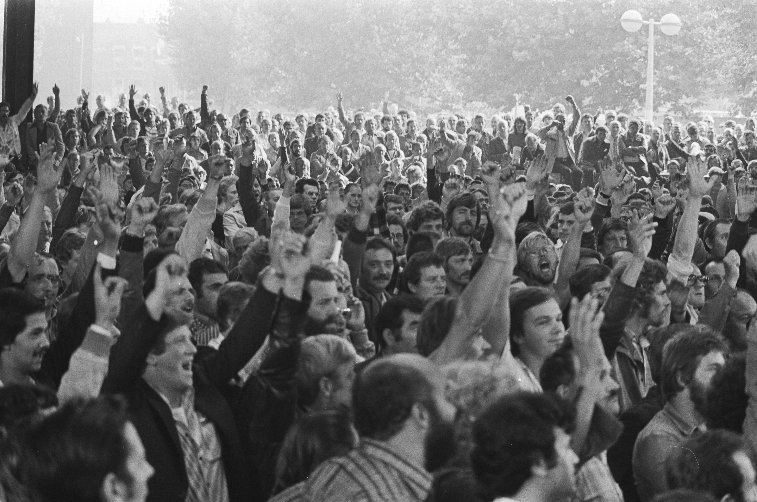
The syndicalist undercurrent
Strikes in the port of Rotterdam
1889-2010
Evert Smit

Slide 2
Research question
Rotterdam port notoriously strike prone, frequent occurrence of wildcat strikes
Notable exception in industrial relations’ system in the Netherlands (“poldermodel”)
Conflict prone ports is an international phenomenon, with long history
How did this strike pattern emerge and develop, why was it so ineradicable?
Looking for underlying causes, rather then immediate and conditioning causes
Definition of ‘strike’: a temporary collective refusal to work by the workers, which is not condoned by their employer
Wildcat or spontaneous strike is not organized by the union

Slide 3
Theory
Tradition of ‘industrial relations’
Katz & Kochan (1992), strategic choice model: focusses on collective bargaining level and formal institutions
‘Employment relations’
Concept of ‘employment relationship’ (Kaufman, 2004) focusses on informal relations at shop floor level
Economic exchange
Authority relationship
Implicit (psychological) contract
Kerr & Siegel (1954), geographical isolation
Miller (1968), universal dockworkers’ subculture

Slide 4
Method
Historical-sociological study (1889-2010): analysis in context of historical developments and evolution of industrial relations’ system
Development of database of all (570) strikes
Wide range of sources (interviews, archives, secondary documents, et cetera)

Slide 5
Findings: the facts

Slide 6
Average number of strikes per annum
1889-1914 | 1915-1940 | 1945-1969 | 1970-1989 | 1990-2009
3,8 | 3,8 | 5,1 | 7,2 | 5,5
79% wildcat | 91% wildcat | 99% wildcat | 81% wildcat | 62% wildcat

Slide 7
Average nummer of striker days per annum jaar per 1000 workers
1889-1914 | 1915-1940 | 1945-1969 | 1970-1989 | 1990-2009
2.007 | 3.464 | 2.219 | 2.672 | 258

Slide 8
Interindustry propensity to strike
Yearly average number of striker days per 1.000 workers
 | 1889-1914 | 1915-1940 | 1945-1969 | 1970-1989 | 1990-2009
Storage and transshipment | 1.243 | 2.232 | 973 | 704 | 40
Mining | 613 | 966 | 95 | 11 | 0
Diamondindustry | 1.869 | 52
Metalindustry | 44 | 447 | 50 | 113 | 16
Building trades | 160 | 450 | 149 | 35 | 153
All branches together | 55 | 213 | 36 | 36 | 20

Slide 9
Findings: underlying causes
Casual labour
Autonomy in the labour process
Dockworkers’ culture

Slide 10
Casual labour
Entirely ‘free’ labour market ( - 1918

Slide 11
Casual labour
Hiring halls (1918 - 1955)
Labour pool (1955 – 2009)

Slide 12
Casual labour
Irregular income, social insecurity
Free spirited mentality
Daily negotiations and conflicts
The logic of direct action
Support for syndicalist unions
After fixed contract in labour pool (1955-2009), pool workers kept on regarding themselves as ‘casual workers’
Strike pattern as the unintended consequence of transaction cost economics (poor management control)
Economic exchange and authority in employment relationship

Slide 13
Autonomy in the labour process

Slide 14
Autonomy in the labour process
Conventional general cargo (breakbulk) transhipment not suited for mechanisation and Taylorist control
Relative autonomy in the labour process: basis of power for dockworkers
Non-contractual bargaining at the shop floor
Small conflicts and direct action with a new look
The dominant explanation in the heydays of general cargo
Containerisation completely changed this picture
Braverman (1985), technology, labour process and shop floor politics

Slide 15
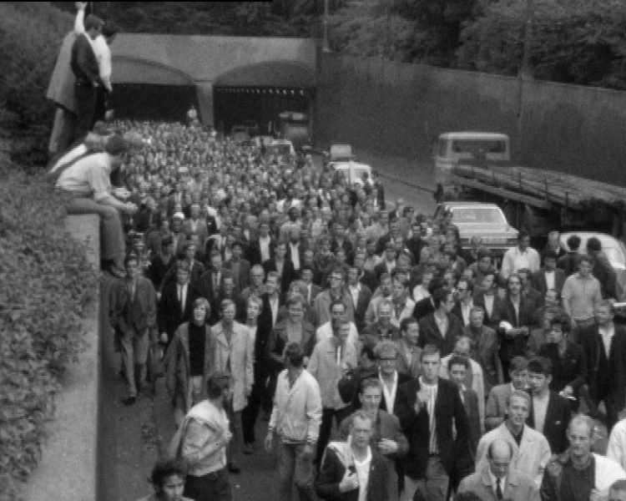
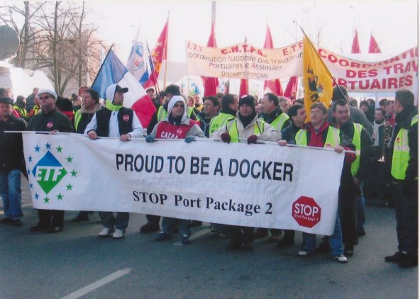
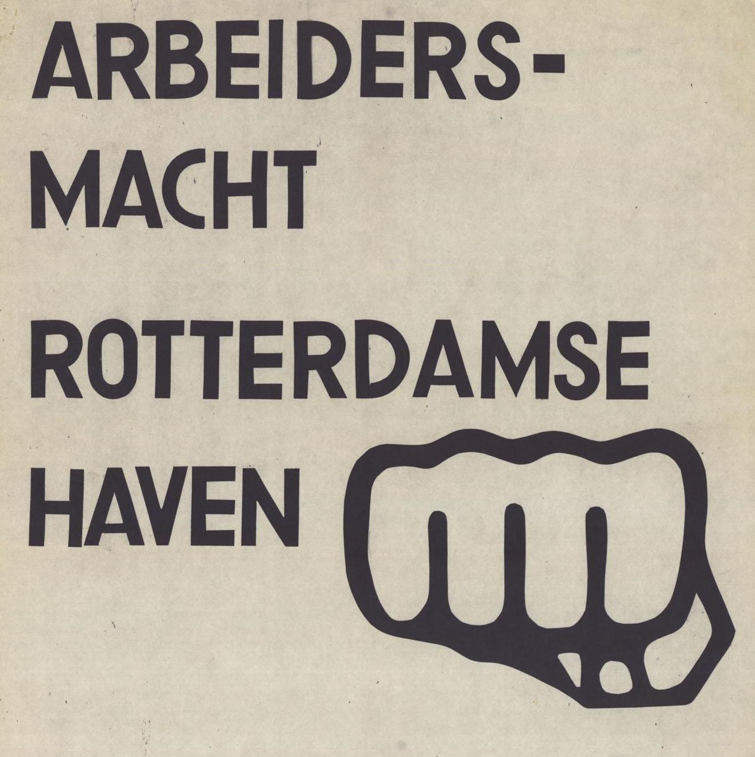
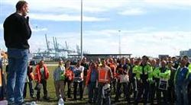
Dockworkers’ culture

Slide 16
Dockworkers’ culture
Rough and casual jobs with low management control fosters independent spirits, and draws tough, combative and virile workers
Teamwork fosters social control and strong solidarity (‘one in trouble, all in trouble’)
‘Casual frame of mind’, anti-intellectualism, anti- or apolitical views
Geen woorden maar daden, hand in hand de kameraden (Feyenoord)
Sterker door strijd (City shield of Rotterdam)
Proud to be a docker
‘Culture lag’ (conditions changed significantly, legacies of the past remain)
Dockworkers’ culture as a ‘repertoire of collective action’ mythologized by the union and source of continuity of strike frequency in container era

Slide 17
Some contextual factors
Major peaks in strike volume appear in times of societal upheaval
Importance of the port in the national economy attracts media and political attention to industrial conflict and fuels self confidence of dockworkers
Globalisation of logistic chains increases structural power of dockworkers and unions
Strategic choices of parties in industrial relations can have severe influence on strike levels

Slide 18
Conclusion
The end of the syndicalist undercurrent?

